Slide 1
Moving Forward Using Lessons Learned to Prevent Central Line-Associated Bloodstream Infections (CLABSI)
June 23, 2022
Part 2 of the 5-part Joint HQIC ‘Preventing Healthcare Associated Infections’
Learning & Action Network Series
Please Note: This LAN is being recorded.

Slide 2

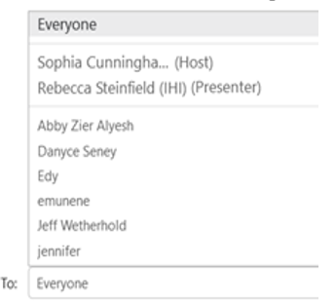
How to Use the Chat Box Feature
To send a Chat Message:
Open the Chat Panel
Enter in Chat:
Name
Role
Organization
State
  Scroll All the Way Down
  Select “To: Everyone”
    Do not select
    “All Attendees”
  Type message in Text Box and press Enter

Slide 3
Agenda
Welcome and Introductions
Setting the Stage and Review of HQIC Data
Presentations by Subject Matter Experts
Sharing of Hospital Success Story
Interactive Q&A/Open Discussion
Key Takeaways
Upcoming Events

Slide 4
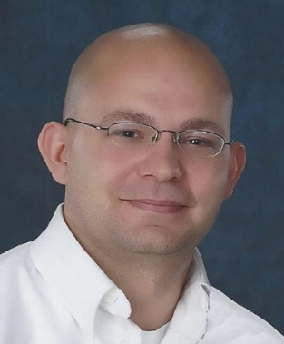
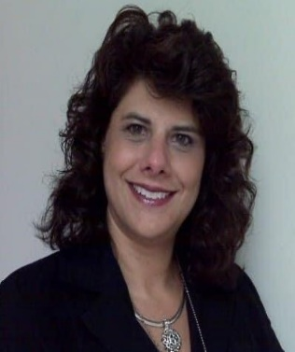
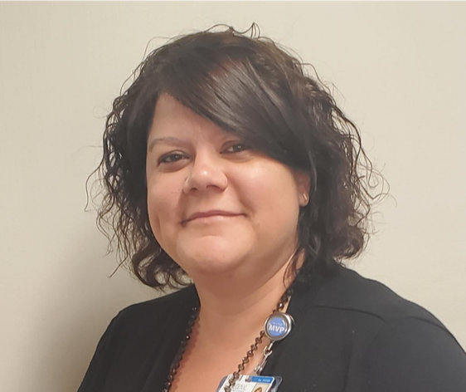
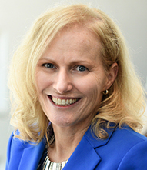
Featured Speakers and Facilitator
Eli K. DeLille, MSN RN CIC FAPIC
Infection Preventionist
Associate Director, HSAG
HSAG HQIC
Christine Bailey, MSN RN CSSGB
Executive Director, HSAG
HSAG HQIC
Jennifer Clary, MS BS RRT
Director, Quality Management
Self Regional Healthcare
HSAG HQIC
Facilitator
Lynda Martin, MPA BSN RN CPHQ
Senior Director Patient Safety
Qlarant
IPRO HQIC

Slide 5
Taking HAI Prevention to the Next Level
5-part HAI Prevention Series Overview
  HQICs and hospital teams working side-by-side
Designed to help drive progress and avoid setbacks
  Harnessing evidence-based practices
  Leveraging insights and lessons learned from the field
  Reframing complex problems and finding value-added solutions for sustainability
Notes:
We’ve created this 5-part HAI Prevention series to work side-by-side with your team to help reframe complex problems and find opportunities that drive value. These LANs, coupled with TA provided by your QI Advisors, are designed to help you see beyond the now to find future opportunities and are derived from existing evidence-based practices, promising practices innovation using lessons learned, collaboration, and insights gleaned from the field by working with enrolled HQIC hospitals.
Help to fuel-ahead & avoid setbacks

Slide 6
Today’s Objectives
Understand the importance of hard-wiring essential evidence-based infection control practices to prevent CLABSI
Gain insight on how to build resiliency into infection prevention programs to withstand future pandemics
Discuss the impact of COVID and lessons learned to devise strategies to enhance patient safety
Hear about a hospitals challenges during COVID and successes of a hospital-wide initiative with improving outcomes
Notes:
As you can see on the slide….We have several objectives today including

Slide 7

Why Have CLABSIs Increased?
Impact of COVID-19
Increased patient acuity
Increased length of stay
Increased device utilization
Staffing concerns
Bundle compliance
Resource availability
Burnout
What must be done versus what should be done (Drift)

Slide 8
Why Focus on Preventing CLABSI?
Preventing CLABSI is a national patient safety priority
An estimated 30,100 CLABSIs occur each year¹
CLABSIs are preventable when essential infection control practices are followed
CLABSIs are the 3rd most frequent cause of HAIs²
Mortality rates from CLABSI range from 12%–25% and significantly increase cost and hospital length of stay²
Estimated cost of each CLABSI is $48,108³
CDC. NHSN Patient Safety Component Manual. https://www.cdc.gov/nhsn/pdfs/pscmanual/pcsmanual_current.pdf
Woodward B, Umberger R. Review of Best Practices for CLABSI Prevention and the Impact of Recent Legislation on CLABSI Reporting. Sage. Nov. 2016. https://journals.sagepub.com/doi/pdf/10.1177/2158244016677747
Agency for Healthcare Research and Quality. Estimating the Additional Hospital Inpatient Cost and Mortality Associated With Selected Hospital-Acquired Conditions. https://www.ahrq.gov/hai/pfp/haccost2017-results.html

Slide 9
Review of HQIC CLABSI Data

Slide 10
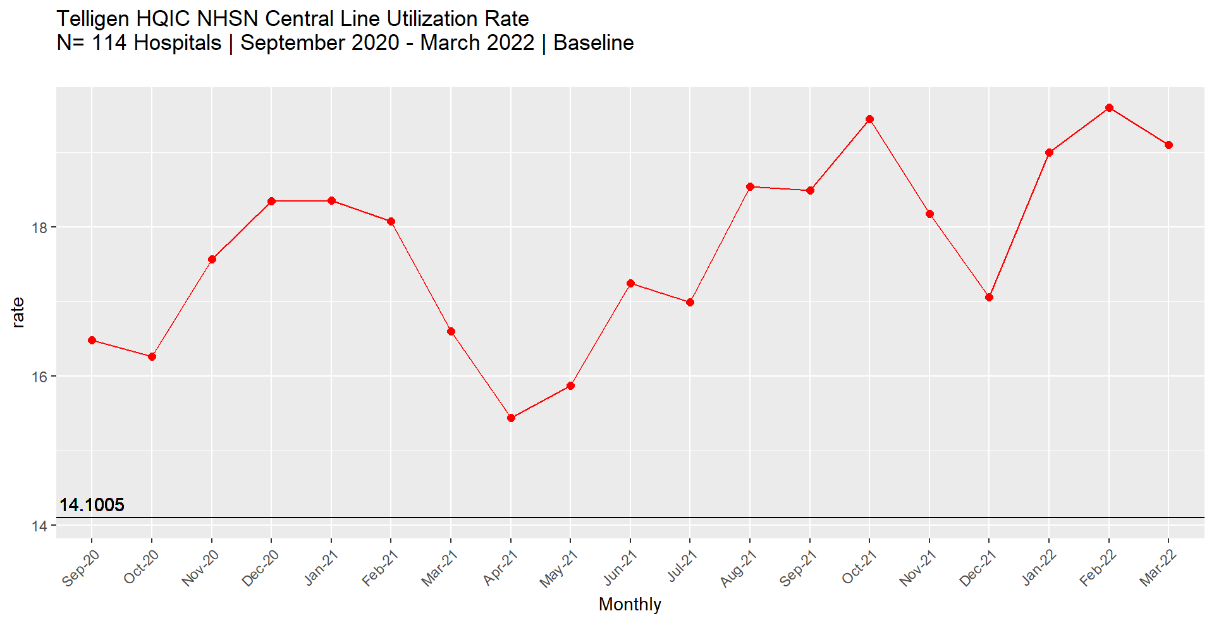
Telligen HQIC – Central Line Utilization Rate
Delta Peak Surge
Omicron Surge Start

Slide 11
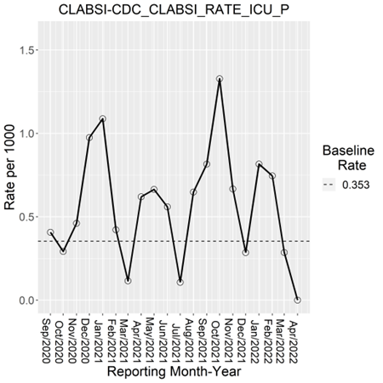
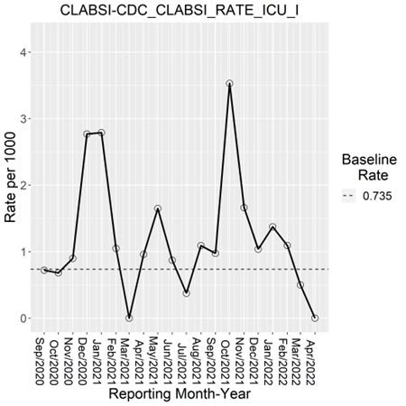
Compass HQIC – CLABSI Rates
Baseline: Hospitals reporting at least 3 months of data between
January 2019 and August 2020
Data Source: NHSN
Hospitals Reporting: 239
Trend Direction: Decreased/Lower is better
Baseline: Hospitals reporting at least 3 months of data between
January 2019 and August 2020
Data Source: NHSN
Hospitals Reporting: 54
Trend Direction: Decreased/Lower is better
*Data from January 2022 onwards is still preliminary
Notes:
CLABSI Rate All Units: The performance rate is 0.61 per 1000 which is a negative 71.54% change from the baseline rate of 0.35 per 1000. Trend has been fluctuating above and below baseline the last few months.
CLABSI Rate ICU, including NICU: The performance rate is 1.33 per 1000 which is a negative 80.56% change from the baseline rate of 0.74 per 1000. Trend has been fluctuating above and below baseline the last few months.

Slide 12
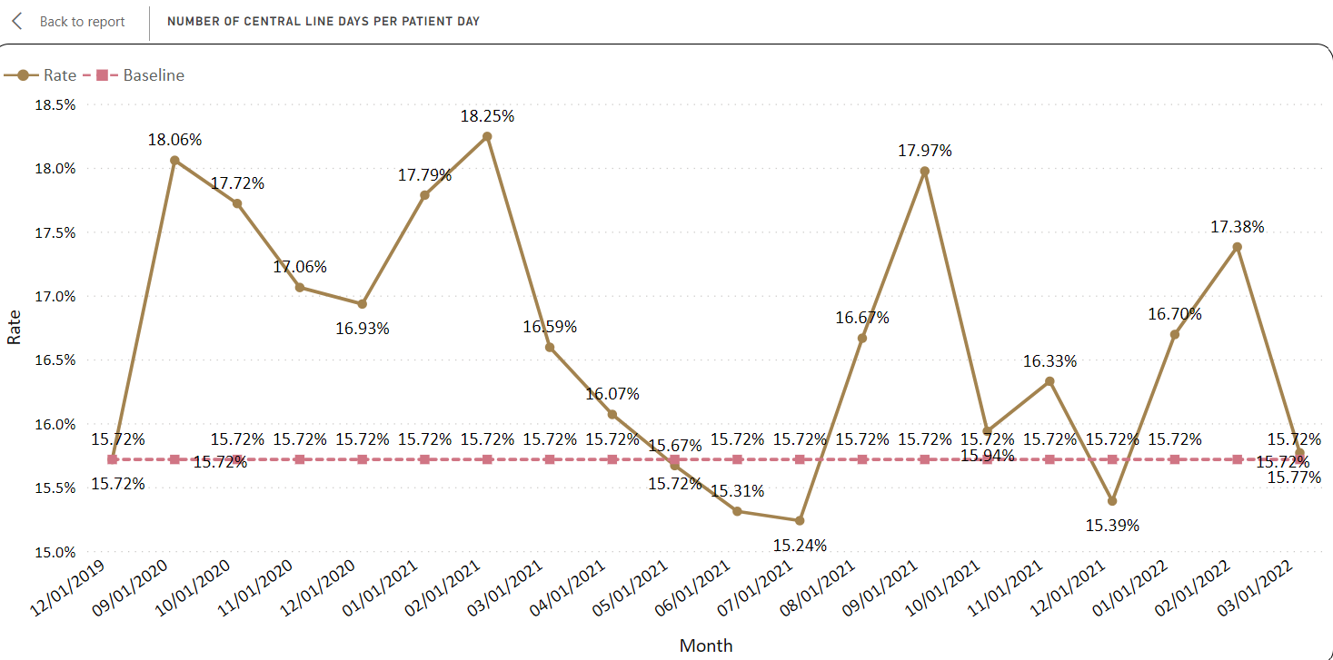
Alliant HQIC: Number of Central Line Days Per Patient Day demonstrates a downward trend over time
N = 116/150 (77%) hospitals reporting
Source: NHSN (Power BI graphs)

Slide 13
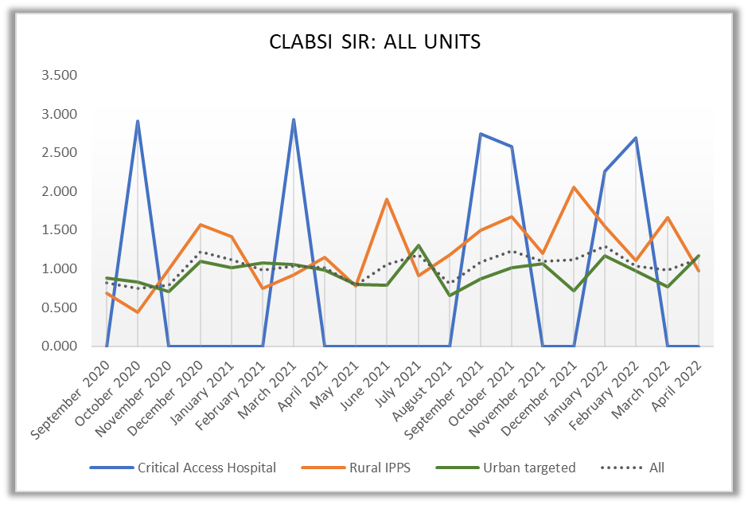
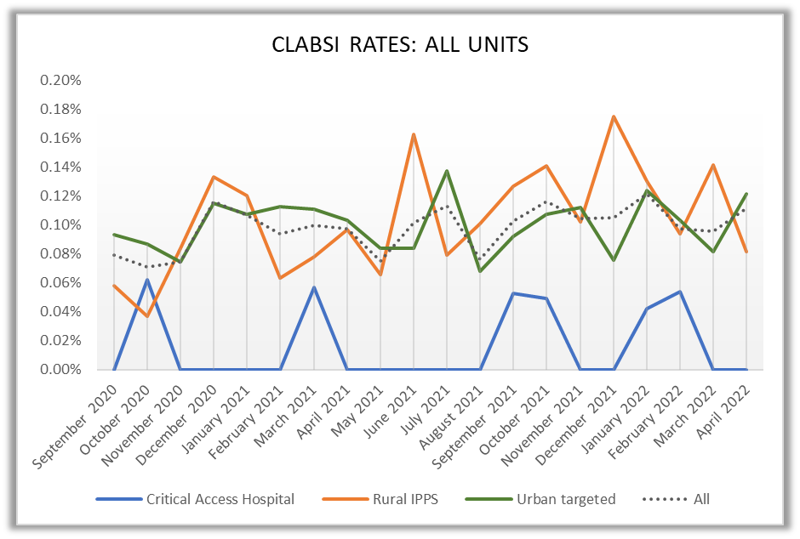
IPRO HQIC CLABSI Data By Hospital Type
Data source: NHSN
Total number of observed events: 771
Total number of expected events: 747.7
20-month SIR: 1.031
Data source: NHSN
Total number of events: 771
Total number in denominator: 784801
20-month rate: .0982%

Slide 14
HSAG HQIC’s Approach to
Healthcare-Associated Infection (HAI)
Christine Bailey MSN, RN, CSSGB
Executive Director
Health Services Advisory Group (HSAG)
cbailey@hsag.com
Eli DeLille, MSN, RN, CIC, FAPIC
Associate Director
HSAG Infection Preventionist
edelille@hsag.com

Slide 15



CDC TAP Strategy
TAP Reports
Run National Healthcare Safety Network (NHSN) TAP reports.
Identify facilities/units with opportunities for improvement.
Target
TAP Assessments
Utilize an assessment tool/survey.
Measure perceptions and practices with the facility.
Identify knowledge gaps in core areas.
Assess
TAP Tools
Access resources and tools.
Follow the implementation guide.
Develop strategies in the targeted facilities/units to reduce
infection rates.
Prevent

Slide 16

TAP Reports Overview
Examines NHSN data
(CLABSI, CAUTI, CDI, and MRSA).*
Targets prevention efforts to
the areas of greatest need.
Uses the CAD metric.
The number of prevented infections needed to reach
the target prevention goal.
*CAD = cumulative attributable difference
CAUTI = catheter-association urinary tract infection
CDI = Clostridioides difficile infection
MRSA = Methicillin-resistant Staphylococcus aureus
The standardized infection ratio (SIR) can be an ambiguous number.
The CAD provides a definite target toward which to aim your improvement efforts.

Slide 17

TAP for Small and Critical Access Hospitals, Too!
We are too small to use TAP!
Many small facilities’ predicted number of infections is less than 1.
You cannot generate an SIR.
You can generate a CAD!

Slide 18
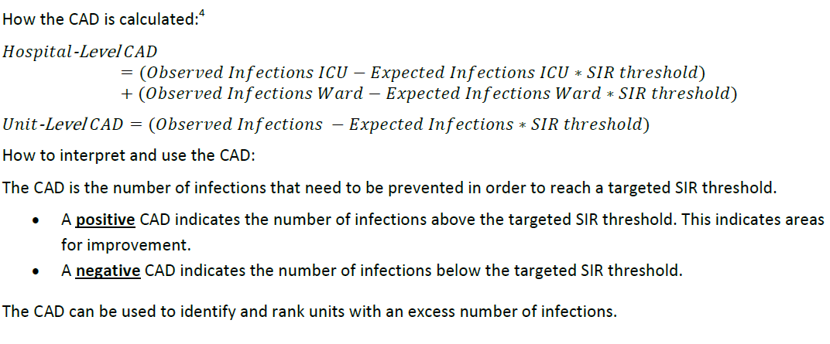
Understanding the CAD
TIP
CAD = (Observed Infections – Expected Infections * SIR Threshold)
Remember your order of operations!
Expected Infections * SIR Threshold – Observed

Slide 19
SUR Reports Overview
Focuses on the utilization of devices.
Requires no additional data entry.
Is a scalable, risk-adjusted
measure.
Determines predicted device
days using a logistic
regression model.
Uses a metric called the
standardized utilization
ratio (SUR).
The SUR provides an external comparison between facilities and units, which can be used to aim your improvement efforts.

Slide 20
Benefits of the TAP/SUR Approach
Reduces facility burden by leveraging mandatory reporting requirements.
Provides real-world improvement targets.
Is a data-driven approach to quality improvement.
Surveillance definitions and mapping provide a true “apples-to-apples” comparison.
  Interventions are more meaningful because they
  target the hospitals and units with the most
  opportunity for improvement.

Slide 21
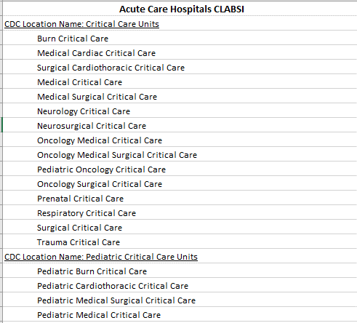
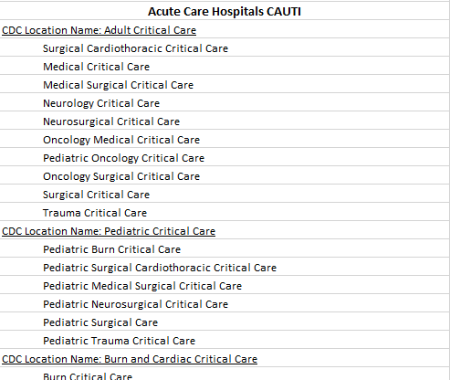
SUR Calculator

Slide 22

CLABSI on the Rise

Slide 23
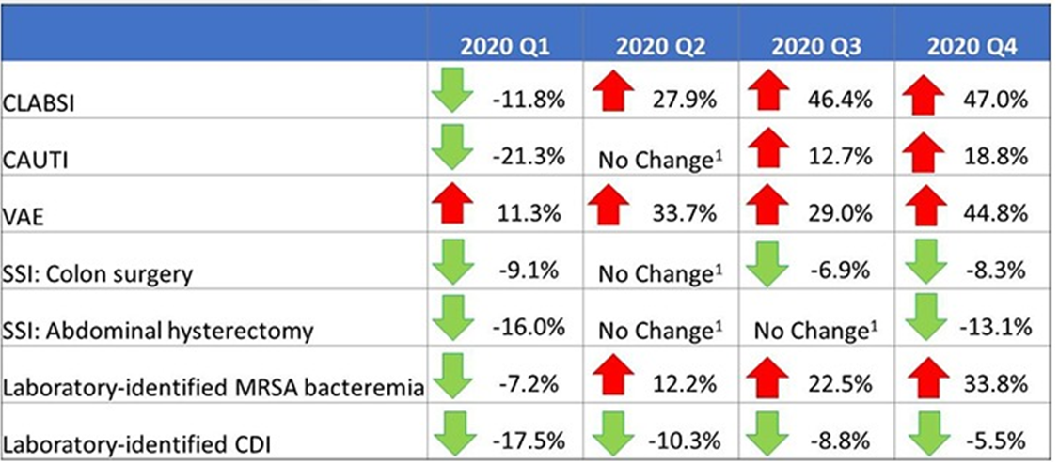
The Impact of COVID-19 on HAIs
The impact of coronavirus disease 2019 (COVID-19) on healthcare-associated infections in 2020: A summary of data reported to the National Healthcare Safety Network | Infection Control & Hospital Epidemiology | Cambridge Core

Slide 24
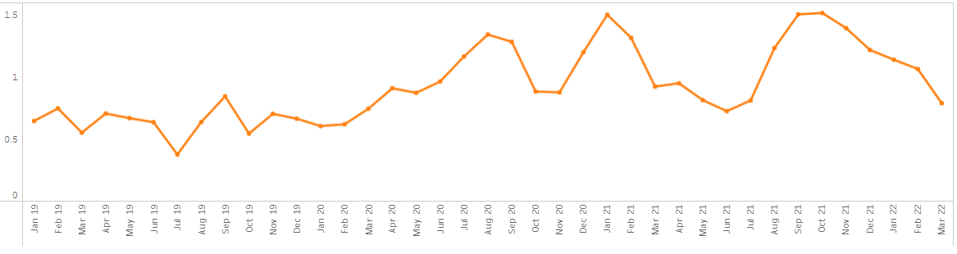
HSAG HQIC CLABSI Performance
CLABSI SIR—All Units
Current
SIR = 1.12
(04/01/2021 – 03/31/2022)
HQIC
Start
2019 Baseline
Pre-Pandemic
SIR = 0.64
Pandemic
Start
COVID Surge
COVID Surge
COVID Surge

Slide 25
Self Regional Healthcare
Success Story
Jennifer Clary, MS BS RRT
Director, Quality Management
Self Regional Healthcare
HSAG HQIC

Slide 26

Self Regional Healthcare
358 Bed Hospital
  DNV and ISO Accredited
  Level 3 Accredited Trauma Center
  DNV Primary Stroke Center
  Accredited Chest Pain Center
  COC Accredited Cancer Center
  Gallup Great Workplace Award Winner
  Get with the Guidelines Gold Plus Stroke and Chest Pain recognition for 2022
  Leapfrog A Rating for Spring 2022
Notes:
Thank you so much for allowing me to talk with you all today. I’m Jennifer Clary, the director of Quality and Patient Safety. Self Regional Healthcare is located in Greenwood South Carolina, which is about 1.5 hours from Columbia and an 1 hour from Greenville. We are a 358 bed, non-for-profit hospital that serves 7 counties and nearly 250,000 people. Our patient population is rural, with a large retiree population. Roughly, we have around 54k ER visits per year. We have over 2,900 team members including 250 employed physicians and a family medicine residency program.
As you can see, we do a variety of things in our hospital, including open heart, iCT brain lab suite, level 3 NICU, and recently robotic surgery. We are accredited by DNV and have specialty DNV accreditation as a Primary Stroke Center. We are also ACS verified for level 3 trauma center, COC accredited cancer center, and ACC Chest pain center.
We also own about 95% of our primary care practice market, specialty market, and have our own home health services.

Slide 27
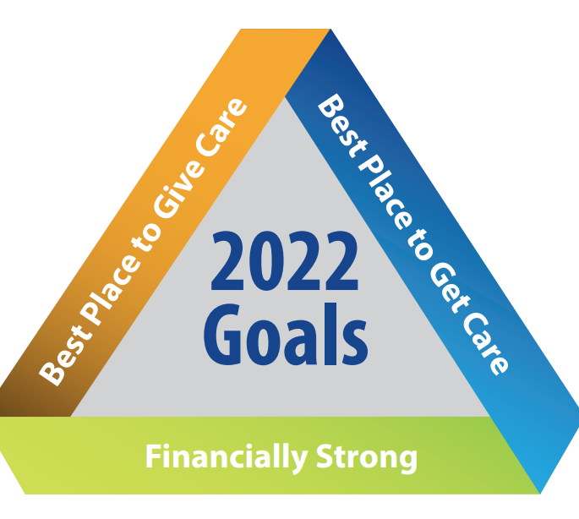
Self Regional Healthcare
Notes:
Our 2022 goals for Self Regional this year are in three strategic aims as seen here. Infections are part of our best place to get care aim, with a focus on reduction in overall CLABSI and CAUTI for FY 2022. Having infections as an organizational goal has been tremendous for self regional as it puts emphasis on that it’s not just infection prevention or nursing services that can reduce infections. It should be an organizational wide approach, where everyone from the person delivering the meal trays to the nurse caring for the patient at bedside understands what their role is in reducing infections. We have also done an organizational approach to hand hygiene, which we all know is the number 1 way to reduce infections.
The other great thing about having infections as part of the organizational goal is the administration commitment in reducing patient harm. It doesn’t have to do with money in the budget or resources, but the constant monitoring of where we are at with our goals and what actions we need to drive them that has been key in this success.

Slide 28
Current State of Self Regional Healthcare 2021
In FY 2020 and FY 2021, more than half of the CLABSIs had been reported in the ICU.
Notes:
So how did this come about? As you can see, in 2020 we had a large increase in CLABSI infections overall from FY 2019. More than half were related to our ICU population and we didn’t seem to be able to get a handle on what was causing them as well as being in the midst of a COVID surge that had no end. As the rest of the country and you all felt, our ICUs were full, we had sicker patients, and the needs for pressors and monitoring just kept increasing. Couple that with staffing challenges and long line utilization, there seemed to be no end in sight. Self Regional went through 2 total surges, including the initial one starting in March 2020 and the other in November 2021.

Slide 29
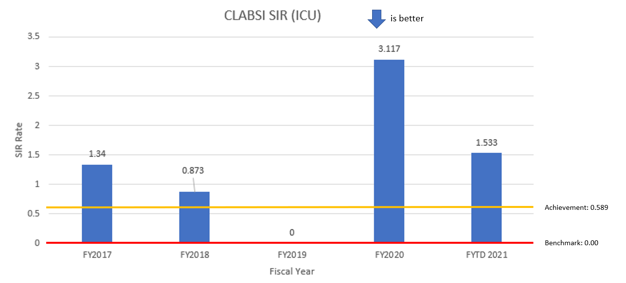
We had seen success in the past……
Notes:
We had seen success in the past in ICU. In FY 2019, you see that we had no CLABSI’s in our ICU. At the time, it was because we had put an emphasis on reducing our number of lines we had daily and multidisciplinary rounding, all of which had not been sustainable once COVID really cranked up. However, it did prove that we were successful once and we could be again.

Slide 30
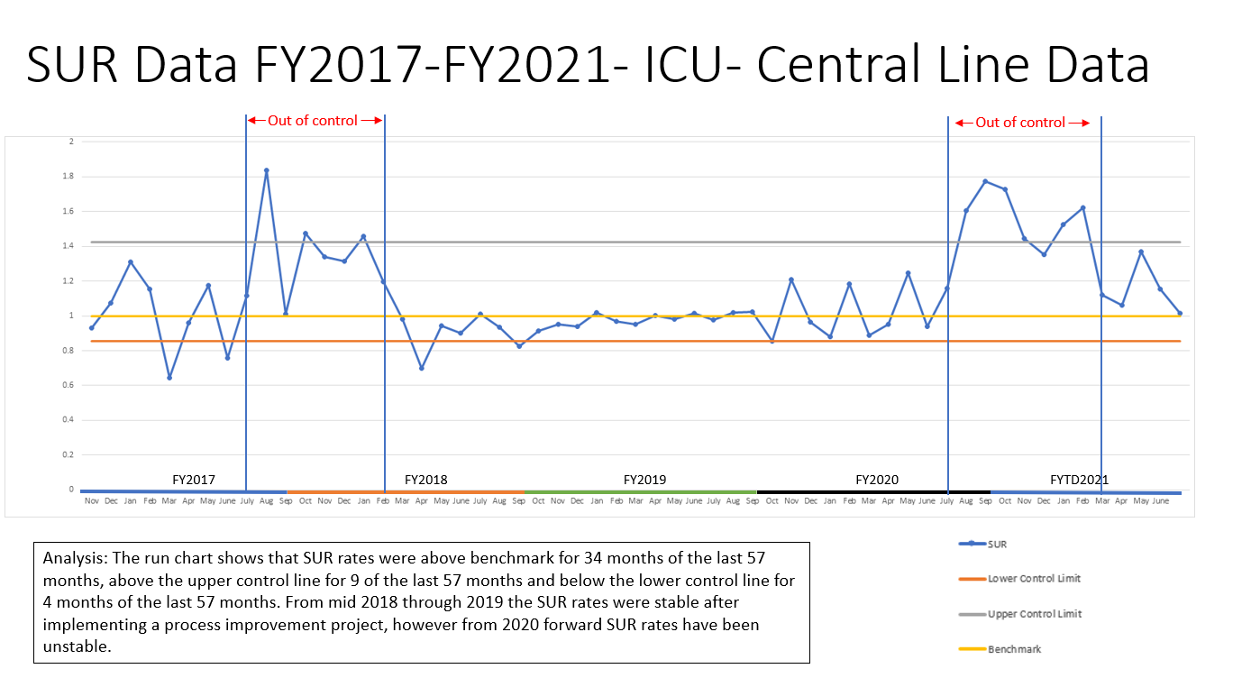
SUR Data fy2017 – FY2021-ICU-Central Line Data
Notes:
This graph shows you our standardized utilization data from FY 2017 through FY 2021. You can see that sustainability period in FY 2019 that kept us right in line with benchmark, but as FY 2020 started to get closer to the COVID surge, we became out of control with our line utilization. As you are all probably aware of, we were seeing sicker patients with COVID, especially during that time period, requiring more ventilator support for longer periods of time. Many weeks we were full in ICU and had an overflow unit as well as holds in our ER. Essentially we had patients everywhere and that is never good when you are trying to ensure that the patient care is consistent.

Slide 31
So What Happened?
Notes:
So what did happen? Well I think we can all guess where I’m going next….

Slide 32
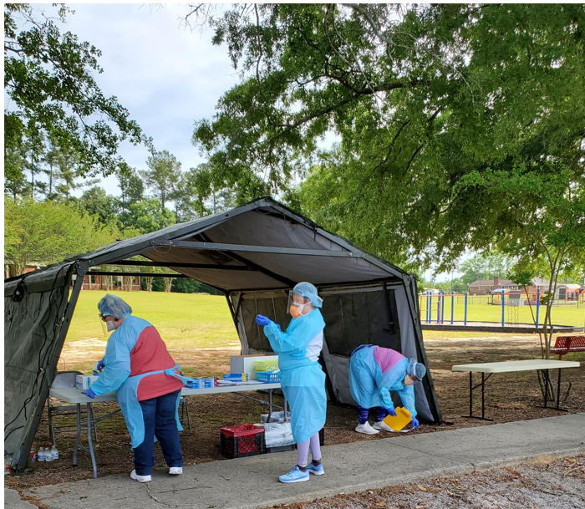
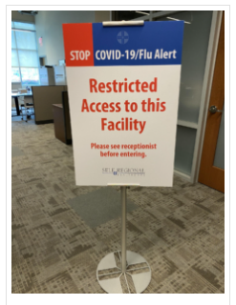

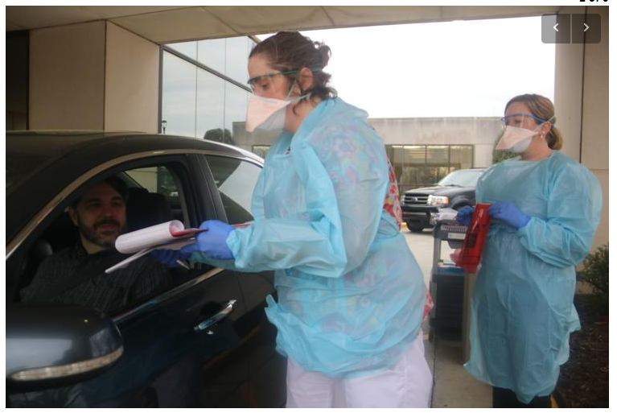
COVID Happened…..
Highest Number of Admits during COVID (1st surge): 235
Highest Number of deaths during COVID (1st surge): 51
Notes:
COVID. Self Regional saw their first COVID positive patient in March 2020. It was rapid fire process improvement, one right after the other, as we joined the rest of the country in taking up drive throughs for testing, restricted visitors, halting elective surgeries, and dealing with staffing, PPE and supply shortages. At one time during our second surge, we had to take up our mobile tent in front of our ER to care for patients with less acuity. It was a trying time and many processes had to be modified to handle the influx of very ill patients.

Slide 33

So What Did We Do?

Slide 34
Process Improvement to the Rescue
30 day Physician Led Team in August 2021
  A comprehensive, multidisciplinary approach to process improvement led by a physician partner champion who can facilitate problem solving for challenging problems,
  Held over 4 meetings
Formed with front line team members in ICU, intensivists, and ER
Goals set: Reduce CLABSI in ICU by 75%
Reduce CAUTI in ICU by 75%
Pre-work done including fishbone diagram and team member interviews, including barriers and THEIR solutions
Each follow up meeting included what was working well and what needed more assistance
Notes:
Even though we were still in COVID mode, we had to do something about the harm we were causing our patients. With Administration’s support, we launched a 30 day physician led team in August 2021. Our physician lead was actually one of our orthopedic surgeons who was also our chief of med staff at the time and had a vested interest in helping us reduce our infections. A physician led team is taking a multidisciplinary approach to a problem, but also having a physician champion that can help us remove barriers that are identified. Since CLABSI start with putting in the line to begin with, we knew it wasn’t just a nursing or physician process. It was both. If we put them in, we have know how and when to remove them and how to care for them in the process.
Our team consisted of 2 of our intensivists, a few ICU RN team members, our IP SME or subject matter expert, and ER RN’s as many of the lines originate in the ER. We committed to only meeting 4 times over the span of a month for no more than 2 hours. The pre-work was done by myself and my infection preventionist, which included a fishbone diagram and interviews with the current staff on what their barriers were. Again, we were still seeing a full ICU with 90% of patients COVID positive during this time.
As you can see, we set a goal to reduce both CLABSI and CAUTI in ICU by 75%

Slide 35
Action Items That Were Identified
Create Daily Line Rounds checklist | Jennifer | 8/4/21 | Complete
Attend revised daily line rounds 10am ICU | Jennifer/Leslie/MD/ICU RN | Beginning 8/4/21 | Ongoing
Daily process measures reporting- email to team | Leslie | Beginning 8/5/21 | ongoing
ICU Visual Board | Leslie | 8/4/21 | Complete
ECC Visual Board | Sherri/Sharon/Carol | 8/5/21 | Complete
Communicate to HS- weekend plan | Sharon | 8/4/21
Add Foley alternatives to ED orientation checklist | Sherri | 8/5/21 | Complete
Confirm Foley alternatives are stocked in the ED | Sherri | 8/5/21 | Complete
Create education for Foley alternatives to ED | Sherri/Carol/Sharon | 8/5/21 | Tool created- education to start 8/6/21
Evaluate blood draws from central lines | Ashley | ASAP
Midline coverage expansion | ?
Notes:
It was important to have actionable items come out of our first meeting. This is our grid from session 1, which was 2 hours long. The main items identified is that we needed to know what we were looking at daily and how to review the lines timely AND get the information back to the team. We also needed to come up with a standardized process of who is involved, when, and how often.
There were other actions also listed that we needed to look at, such as alternative methods to putting in a foley or central line, if they staff were even aware of the alternative methods or if we had them stocked, and how to incorporate our midline team (which is our cath lab team) in on this project. It doesn’t help if we identify a potential change in the line, such as a PICC or midline, but there’s no one to put it in.

Slide 36
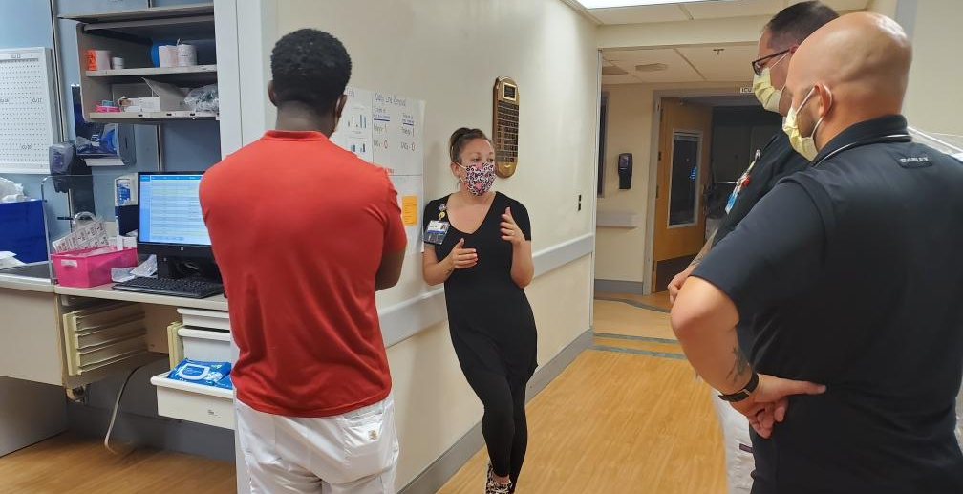
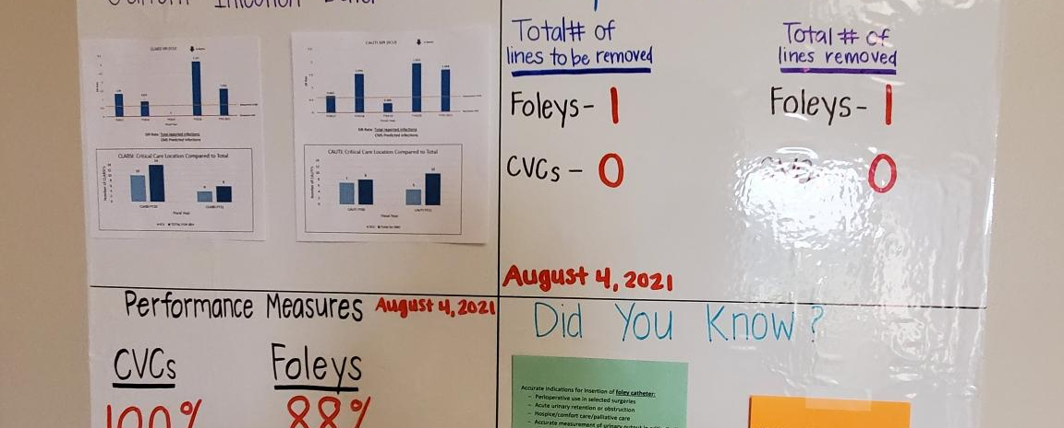
Line Rounds in ICU
Included Quality Director, Infection Prevention, Critical Care Leadership (5 days a week at a set time)
All line investigation was done ahead of time
Conversations with RN and Physician on pulling lines and/or alternatives
Follow up done by Infection Prevention before the end of the day
Visual cues for team to know where their progress is
Daily scorecard sent out to leadership team on progress
Notes:
Line rounds was a huge component of this project. I want to be upfront to say that I didn’t add any additional FTE’s to pull this off. We have two infection preventionists so we worked to streamline some duties to have one dedicated to our critical care areas. For the first few months, I attended the scheduled line rounds 5 days a week, even covering some of the days. Typically we spent our morning looking at the new lines and why they were in by a checklist (this did include foleys). With a full 30 bed ICU, this became pretty cumbersome so we learned what was pertinent to know before heading to the ICU at 10am. There we would meet up with the critical care leadership and walk room to room with the primary RN, sometimes catching them while they were in the room, to discuss the lines. We asked the basic questions, such as why it was in and if they thought we could do something different, before rounding with the intensivist to go over the plan and get their buy in. I will tell you this wasn’t easy during our really busy times but with them being part of the solution to begin with, they knew we were coming. There was some initial push back but we worked through those issues.
This wasn’t a nursing project with quality supervising. The IP would do her rounds and then she would even check on the key things related to maintenance, such as checking for caps and dressings. We wanted to be a helping hand, not a hinderance to our nursing staff and provided many times the daily maintenance ourselves if it hadn’t been done yet (with the nurses’s approval of course!)
One thing we did implement was a follow up at the end of the day. Most days in the beginning you would feel great by the progress, only to learn that the midline order didn’t get placed or the foley didn’t get pulled and it was frustration for everyone. Any line that was identified as being a need to be pulled or replaced, IP would do another end of day round to make sure it happened. It also gave the IP time to round on any barriers, provide education to the team, and update her board. Visibility of the data was key, which I will talk about in the next slide.
Also, to hold our project accountable, a daily scorecard was sent out to the team, the physician lead, and administration. If something wasn’t looking good, we pointed that out and came up with actions to improve the process. I can’t stress enough how communication is key.

Slide 37
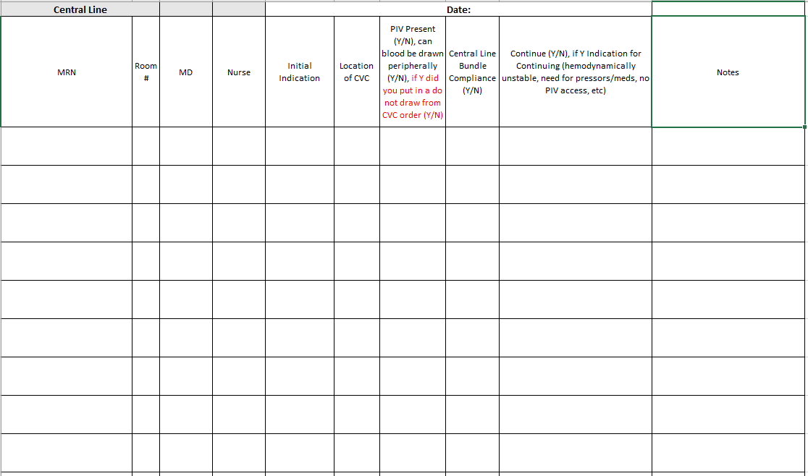
Central Line Checklist
Notes:
This is a copy of our central line checklist that is still used today. We have had a few version changes since the beginning of the project. This information is filled in by one of our quality department personnel for our infection preventionists and then logged into a spreadsheet.

Slide 38

Where is the Data?
Notes:
Probably the most important piece of any process improvement is data. Without it, you can’t find the opportunities and improve upon it. In our initial project, we identified what was going to be our outcome measure and what process measures make the outcome measure successful. We do keep up with both still.

Slide 39
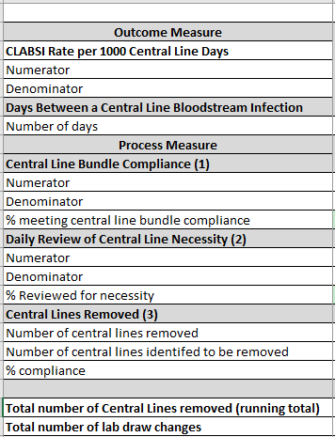
Outcome measures
Notes:
This are our outcome measures and process measures. As you can see, we used the basic SIR rate as our outcome measure. Our process measures were the compliance measures to the bundle, such as caps, labels, and dressings. All that data capture was done by infection prevention daily as she did her rounds in the unit. Any non-compliance was managed up to the critical care leadership for follow up. Missing caps and no date on dressings were our culprits in the beginning. We also during this time, looked at how baths were done and if they were cumbersome to the staff. This led to a more user friendly change in our foley care with the RN input and trial. We saw great increase in compliance for foley care after the implementation of these wipes.
Another data point to capture was if the lines were identifying were actually being removed. All this data was transferred to the nursing board inside the unit daily so that the team could see where we were at and where our opportunities were.
We were able to reach 62 days without a CLABSI infection before we had our first one. We wanted to celebrate the small wins and not let the team get discouraged so we celebrated at 50 days for CLABSI and 100 days for CAUTI.

Slide 40
It Can Be Done…..
2021
In FY Quarter 1 2021, we were utilizing central lines more than 82% of like units across the country and had already experienced 3 CLABSI in our ICU alone.
2022
In FY Quarter 1 2022, only 37% of hospitals are using fewer central lines than we are with only 1 CLABSI.
Notes:
Our journey wasn’t easy at all, especially in the light of the COVID pandemic. The biggest success to me is the fact that we reduced patient harm but also we have brought this great awareness to our nursing staff. Now when we go on the unit, they already have reviewed their line and are telling us if it can come out or not. That’s not standard work. That’s not us pushing it on them until they finally get it.
That’s a culture shift. We don’t do the work everyday. I can’t even imagine what nurses around the country have gone through during the last two years but I can tell you that they are resilient. They want to do what’s right for their patient and identifying something like this has really empowered them to speak on behalf of their patient. Do we still have our issues? Of course! Process improvement is a continuous cycle. It doesn’t happen overnight and it certainly doesn’t sustain itself without constant monitoring.
It’s also a team sport. Everyone has to have a position to play and they have to know what their ultimate goal is, but also when to change up the playbook and step back for a second to see what the opportunities are. As you saw in our actions, we are still working through blood draws off central lines. We still have a long way to go with that process. The best part is that this rounding is standard work. It’s built into our daily tasks and isn’t just happening when we can get to it.

Slide 41
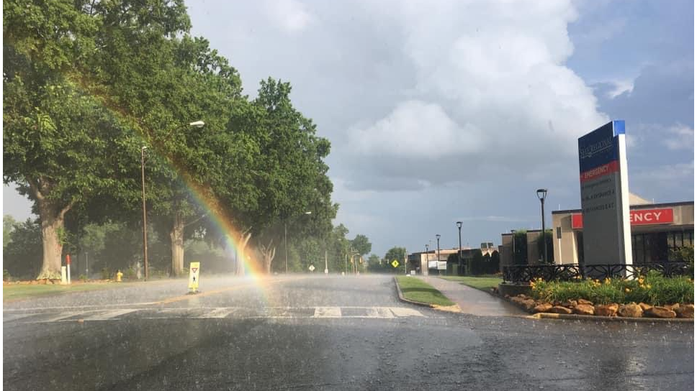
image
Notes:
In closing, I want to definitely thank our team. They do the work every day and without them, none of this would be possible. As you can see, there is a rainbow, you just have to find it. This was taken outside of our ER during COVID by one of our team members and it gave us hope like I hope it gives you hope for your process improvements and providing excellent care to patients. Thank you.

Slide 42
Interactive Discussion: Speakers & Attendees
What are some challenges, barriers & best practice strategies with CLABSI prevention?
How can HQICs best support hospitals going forward?
How can hospitals partner with patient & families to support CLABSI prevention?
How do we best identify & close any disparity/gaps in care related to CLABSI prevention?
Enter in Chat:
Thoughts
Experiences
Questions

Slide 43




HQIC Resources
https://hqic-library.ipro.org/
https://quality.allianthealth.org/
LINK Telligen QI Connect Portal
www.hsag.com/hqic-ip
https://www.ihconline.org/initiatives/hospital/hqic

Slide 44
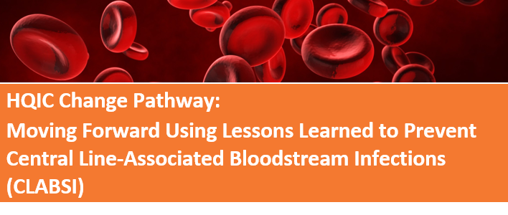
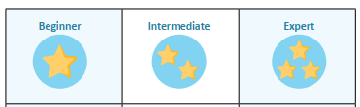
Tools & Resources
HQIC Change Pathway for Driving Improvement
Adapt and use to help address your opportunities and/or augment existing interventions
Summary of LAN topics discussed
Compilation of challenges, barriers & best practices for implementation
Links to tools & resources for planning & executing your QI project

Slide 45
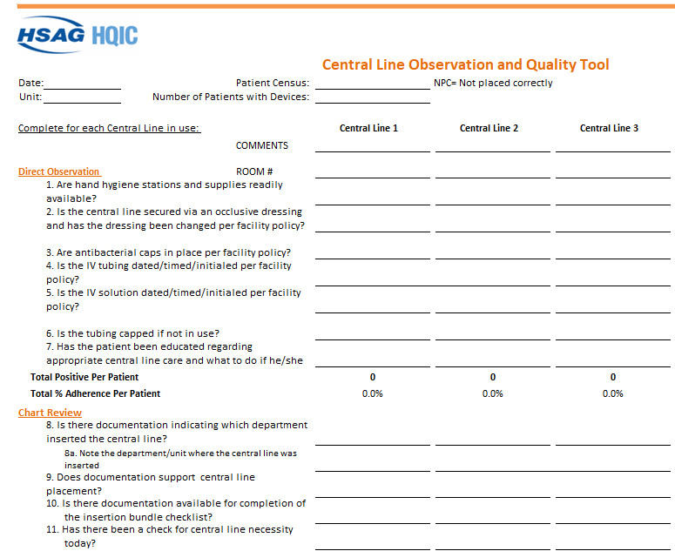
Audit Tools
www.hsag.com/hqic-ip

Slide 46
Key Takeaways
Leadership engagement critical to resilience & sustainability to endure future pandemic &/or other disruptions
Standard work processes & accountability at all levels
Front-line staff involvement & buy-in
Establish data metrics & goals, monitor & share progress
Leverage NHSN – it’s all there – TAP & CAD reports
Use the SUR Calculator for ‘near real-time’ data
Culture shift – be patient it takes time

Slide 47
Upcoming LAN Events
July 28, 2022 | 1 – 1:30 p.m. ET
MDRO Prevention
Registration Link for Attendees:
https://telligen.zoom.us/webinar/register/WN_nZOIMRvaQtaPVs3VODJhRg

Slide 48
Contact Us
Alliant HQIC Team
Karen Holtz,
MT (ASCP), MS, CPHQ
Alliant Health Solutions
Karen.holtz@allianthealth.org
View our Website
IHC Team
Melissa Perry, MSW, LCSW
Hospital Quality Initiatives Project Coordinator
perrym@ihconline.org
View our Website
IPRO HQIC Team
Rebecca Van Vorst, MSPH, CPHQ
HQIC Project Manager
RVanVorst@ipro.org
Lynda Martin, MPA, BSN, RN, CPHQ
martinl@qlarant.com
View our Website
Telligen HQIC Team
Meg Nugent,
MHA, RN
HQIC Program Manager
mnugent@telligen.com
View our Website
Speakers Contact Information
Eli K. DeLille, MSN RN CIC FAPIC
Infection Preventionist
Associate Director, HSAG
HSAG HQIC
edelille@hsag.com
Christine Bailey, MSN RN CSSGB
Executive Director, HSAG
HSAG HQIC
cbailey@hsag.com
Jennifer Clary, MS BS RRT
Director, Quality Management
Self Regional Healthcare
HSAG HQIC
jclary@selfregional.org

Slide 49
Thank You for Attending Today’s Event
We value your input!
Please complete the brief survey after today’s event.
This material was prepared by the IPRO HQIC, a Hospital Quality Improvement Contractor, under contract with the Centers for Medicare & Medicaid Services (CMS), an agency of the U.S. Department of Health and Human Services (HHS). Views expressed in this material do not necessarily reflect the official views or policy of CMS or HHS, and any reference to a specific product or entity herein does not constitute endorsement of that product or entity by CMS or HHS. IPRO-HQIC-Tsk56-22-220

