Slide 1
Exploring Strategies to Prevent Hypoglycemia in Hospitalized Patients
Compass, Telligen, IPRO and Alliant
Joint Hospital Quality Improvement Contract (HQIC) Learning and Action Network
October 28, 2021
Please note, this event is being recorded

Slide 2
Collaborating to Support Your Quality Improvement Efforts

Slide 3
Housekeeping
Lines have been muted upon entry to reduce background noise
We encourage you to ask questions for the presenter(s) throughout the event using the Q&A feature
Please direct technical needs and questions to the Chat Box

Slide 4
Today’s Agenda
Welcome and Introductions
Setting the Stage: Data Discussion
Strategies to Prevent Hypoglycemia in Hospitalized Patients
Q&A
Additional Tools and Resources
Key Takeaways
Upcoming Events
Post-event Evaluation

Slide 5
Today’s Objectives
Explain why hypoglycemia in inpatients is dangerous and can lead to catastrophic results
How to easily and simply “find the data” if average daily census is small
List the common process errors that lead to hypoglycemia
Identify which process failures are most common in their hospital and improvement
Examine how social determinants of health can affect hypoglycemia in patients

Slide 6
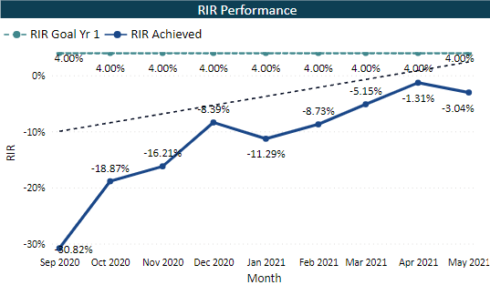
Alliant HQIC - Glycemic ADEs per 1,000 Diabetic Discharges On Track to Meet 4.0% Improvement Goal
Performance data show variation over time compared to calendar year (CY) 2019 baseline (5.74). Overall, there is a downward trend.
Relative Improvement Rate (RIR): Demonstrated improvement from Sep 2020 - May 2021.
On track to meet 4.0% improvement.
N = 146/150 (97.3%) hospitals
Source: CMS Claims (Power BI)

Slide 7
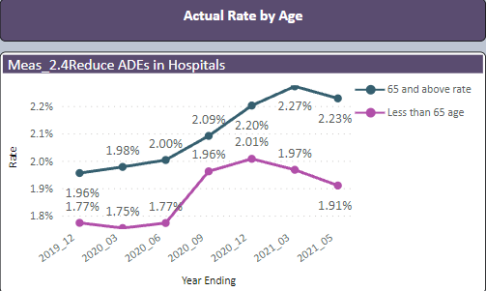
Alliant HQIC - Reduce ADEs* in Hospitals by Race and Age
Actual Rate by Race: Asian patient population (purple) trended highest in prior year. Overall, highest in Black patient population (red line).
Actual Rate by Age: Overall, age 65 and above trending upward (dark green line).
* ADEs include opioids, hypoglycemic and anticoagulants
Source: CMS Claims (Power BI)

Slide 8
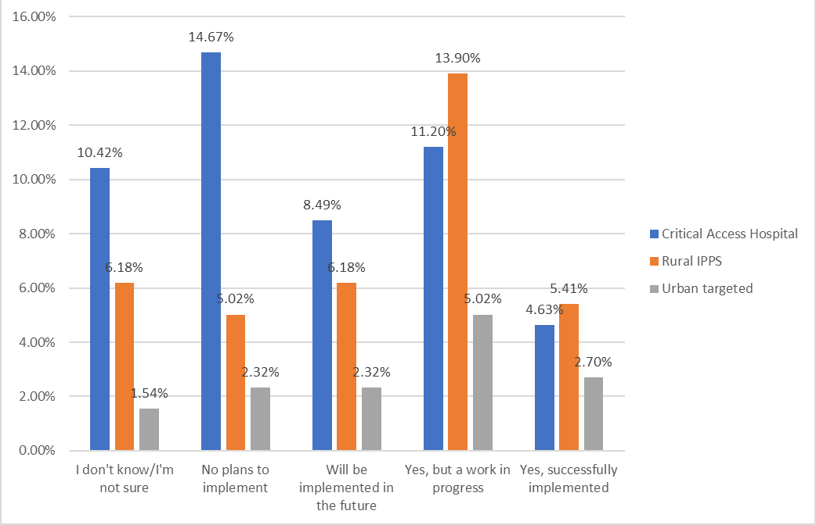
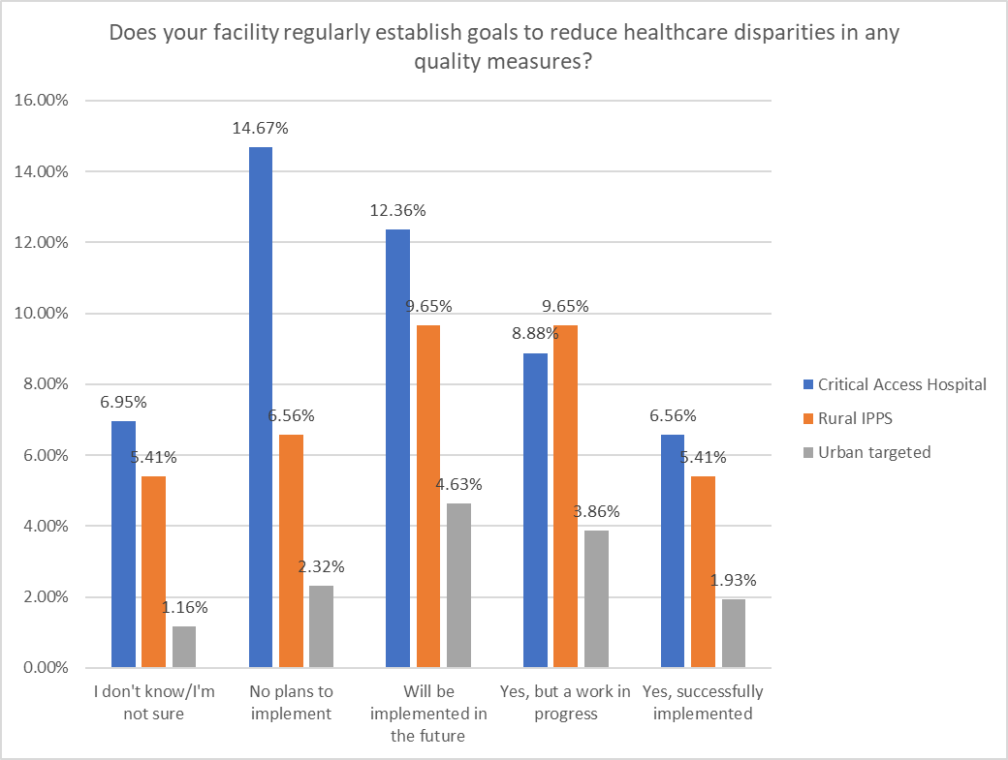
IPRO HQIC Hospital Baseline Assessment Health Equity-Related Questions
Does your facility use data or other means to identify gaps in care by REaL or SDoH?
Does your facility regularly establish goals to reduce health disparities in any quality measures?
N = 254
N = 254
Over 55% stated would like education and assistance with both
Notes:
IPRO HQIC Hospital Baseline Assessment Results on Two Health Equity-Related Questions
Results from 254 hospitals out of IPRO’s 270 hospitals
Broken out by critical access, rural & large urban hospitals
Reflect that over 55% are looking for additional technical assistance & education
Graph on left - use of REaL or SDoH data
43% stated yes - they fully implemented or it’s a work in progress
18% that don't know
22% that have no plans to implement
Graph on the right - “Does your facility regularly establish goals to reduce health disparities in any of your quality measures?”
36% stated yes - they fully implemented or it’s a work in progress
13% that don't know
24% with no plans to implement
Action Plan - IPRO HQIC is working with their hospitals & drilling down into understanding the barriers & challenges with regards to the “no plans & don't knows” responses in order to devise targeted solutions to drive change & forward progress

Slide 9
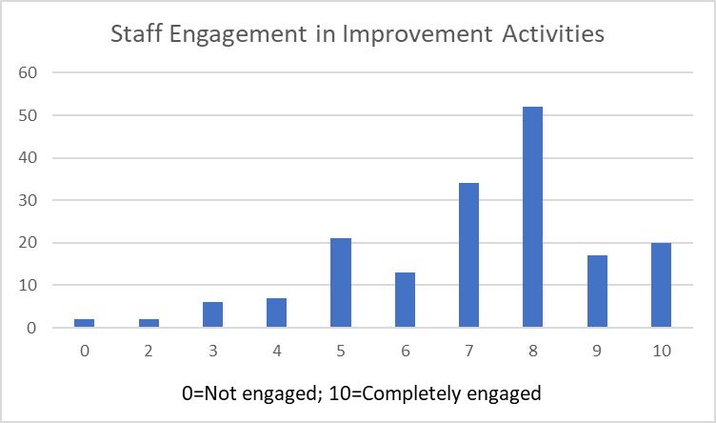
Telligen HQIC: Hospital Baseline Assessment
Indicate how engaged your hospital’s front-line staff are with the organization’s improvement efforts in this area (0=not engaged; 10=completely engaged) N=174
Enter your thoughts in Chat!
What are strategies you could attempt to gain staff buy-in related to adverse drug event (ADE) quality improvement activities?

Slide 10
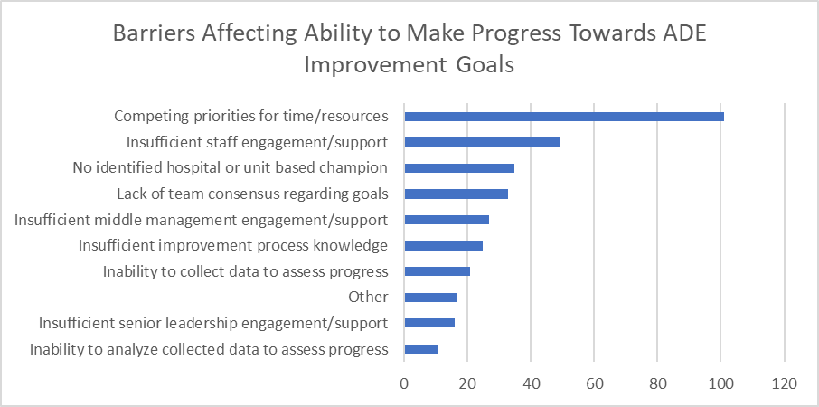
Telligen HQIC: Hospital Baseline Assessment
Which barriers are affecting your hospital’s ability to make progress?
Overview of Adverse Drug Event (ADE) Assessment (HQIC Hospitals) Data from 174 HQIC Enrolled Hospitals

Slide 11
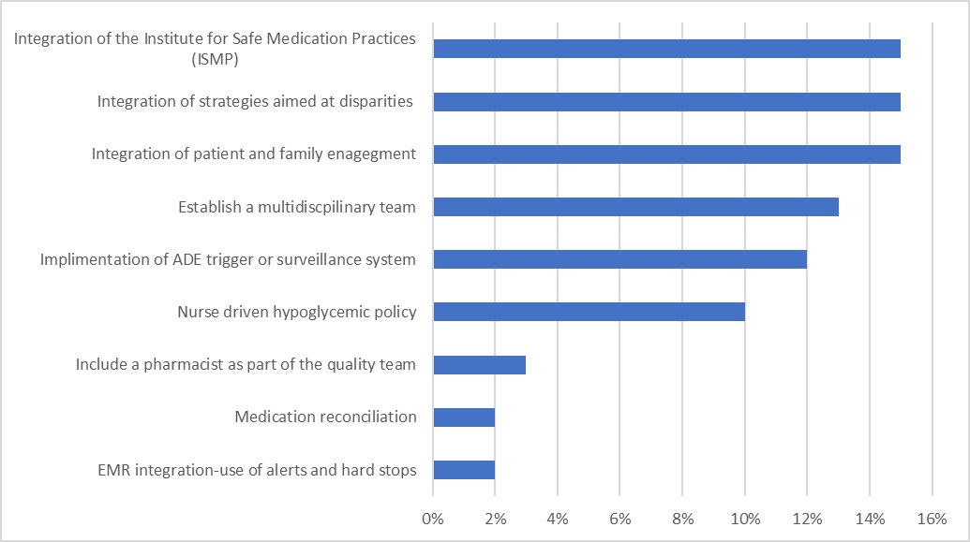
Compass HQIC: Quality Improvement Work Plan Data
Best Practice Interventions Not Started or Needing More Information (N=119)
Notes:
Of the 283 hospitals in the Compass HQIC, 119 selected Adverse Drug Events as a top three strategic priority to address during the first year of the program. This chart displays the best practice interventions that were identified as either not started and/or needing more information.

Slide 12
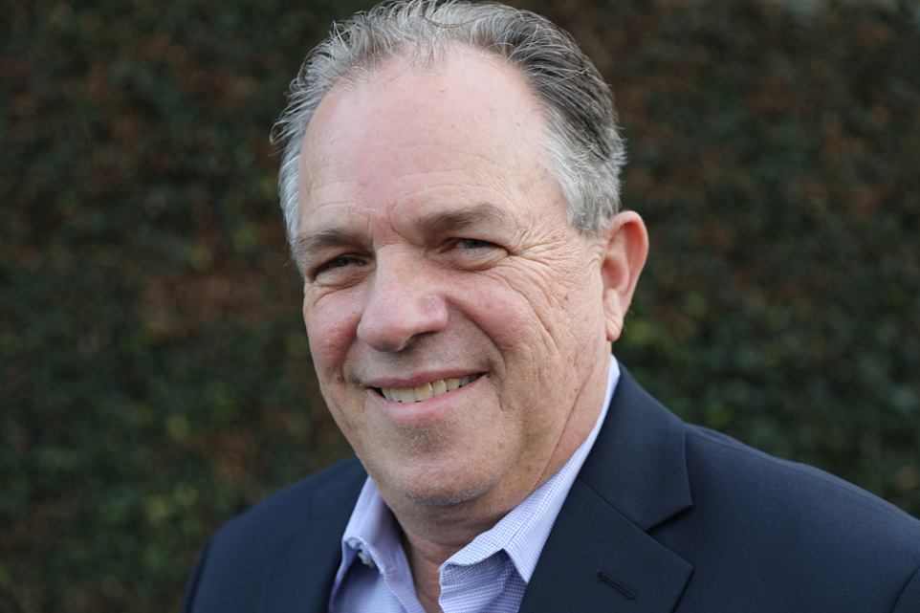
Welcome to Today’s Speaker
Steve Tremain, M.D., FACPE
Physician Improvement Advisor
Cynosure Health
Notes:
Steve Tremain is a Physician Improvement Advisor with Cynosure Health. Board certified for 35 years in Family Medicine and now retired from active clinical practice, Dr. Tremain worked as a hospital-based clinician and teacher and served as Chief Medical Officer for a large integrated public system for over 20 years. He was the executive sponsor for improvement teams that were awarded mentor status by the Institute for Healthcare Improvement in the areas of medication reconciliation, rapid response teams, and ventilator associated pneumonia.
Currently Dr. Tremain works as a national and international Improvement Advisor and serves as the national clinical lead for the Convergence/Cynosure HQIC efforts to reduce hospital-based harm due to adverse drug events (ADEs). Previously, he helped lead AHA/HRET’s efforts to reduce ADE’s from 2012-2019. In addition, he teaches and consults regarding the culture of safety, process reliability, leadership and physician engagement throughout the United States and Canada.
Steve is a Certified Physician Executive and a Fellow of the American College of Physician Executives. He earned his MD degree from the UCLA School of Medicine.

Slide 13
Strategies to Prevent Hypoglycemia in Hospitalized Patients
Steven Tremain, MD, FACPE
October 28, 2021
Iowa Healthcare Collaborative (IHC)

Slide 14
Objectives
At the conclusion of the course, attendees will be able to:
Describe common social contributors to hypoglycemia admissions/readmissions
Explain why hypoglycemia in inpatients is dangerous and can lead to catastrophic results
Describe how to easily and simply “find the data” if average daily census is small
List the common process errors that lead to hypoglycemia
Identify which process failures are most common in THEIR hospital and design design specific local improvement initiatives to address those failures

Slide 15
Social Determinants of Health and Hypoglycemia

Slide 16
Social Determinants of Health
What is this?
The conditions in which we are born, live, learn, work, play, worship, and age – known as social determinants of health (SDOH) – have a profound impact on health
They influence the opportunities available to us to practice healthy behaviors, enhancing or limiting our ability to live healthy lives
CDC

Slide 17
Social Determinants of Health
Why are they important?
Contribute to the stark and persistent chronic disease disparities in the United States among racial, ethnic and socioeconomic groups
Systematically limiting opportunities for members of some groups to be healthy
Create health inequities which persist across generations because of structural policies and practices that have systematically limited health access and opportunities

Slide 18
Social Determinants of Health
How can we tackle this?
Built environment
Community-Clinical Linkages
Food and Nutrition Security
Social Connectedness
Tobacco-Free Policy

Slide 19
Social Determinants of Health
How can we tackle this?
Built environment
Community-Clinical Linkages
Food and Nutrition Security
Social Connectedness
Tobacco-Free Policy
What’s this have to do with Hypoglycemia?

Slide 20
Social Determinants of Health and Hypoglycemia
Monthly Food Cycle Insecurity
Diabetics with income less than national median 7% more likely to be admitted to ED or hospital with hypoglycemia
This variance erased with federal supplemental nutrition programs
Cost savings $54M annually
Other factors
African- American race
Medicaid insurance
Mental health diagnosis
Poor care coordination

Slide 21
Inpatient Hypoglycemia: What’s all the Fuss About?

Slide 22
Cerebral Effects of Hypoglycemia
Hypoglycemia
Cerebral intracellular “hypoxia”
Confusion
Death
Hypoglycemia = Cellular Hypoxia

Slide 23
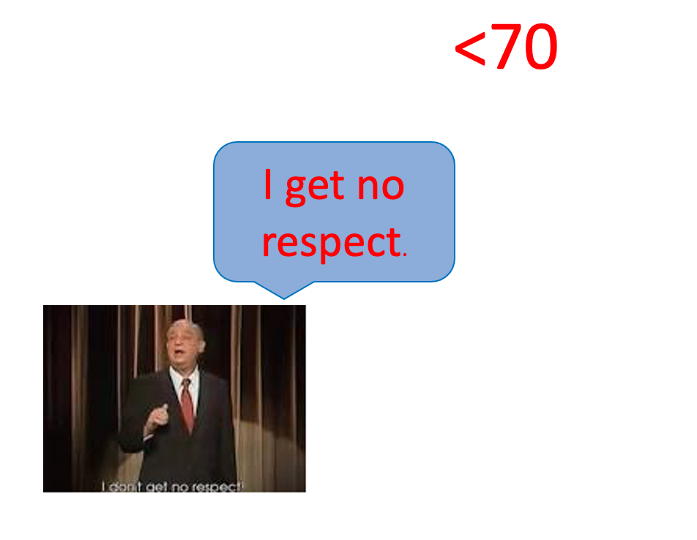
The Rodney Dangerfield of ADEs
“The cost of doing business.”
“They are OK.”
”Nothing bad happened”
”Easy to fix.”

Slide 24
So…Is a blood glucose <70 a problem?
At minimum, every hypoglycemic event flags process errors
Normoglycemia in hospitalized patients
Increases Morbidity and mortality (NICE SUGAR studies, 2009)
Target should be 140-180 mg/dL
ADA: <54 mg/dL is clinical hypoglycemia
“Likely unable to rescue self”

Slide 25
Forget what you know about outpatient glucose control

Slide 26
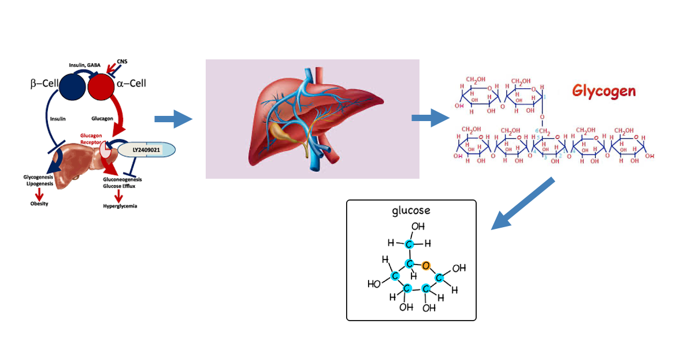
Let’s Talk Physiology!
When the blood sugar drops…what happens?

Slide 27
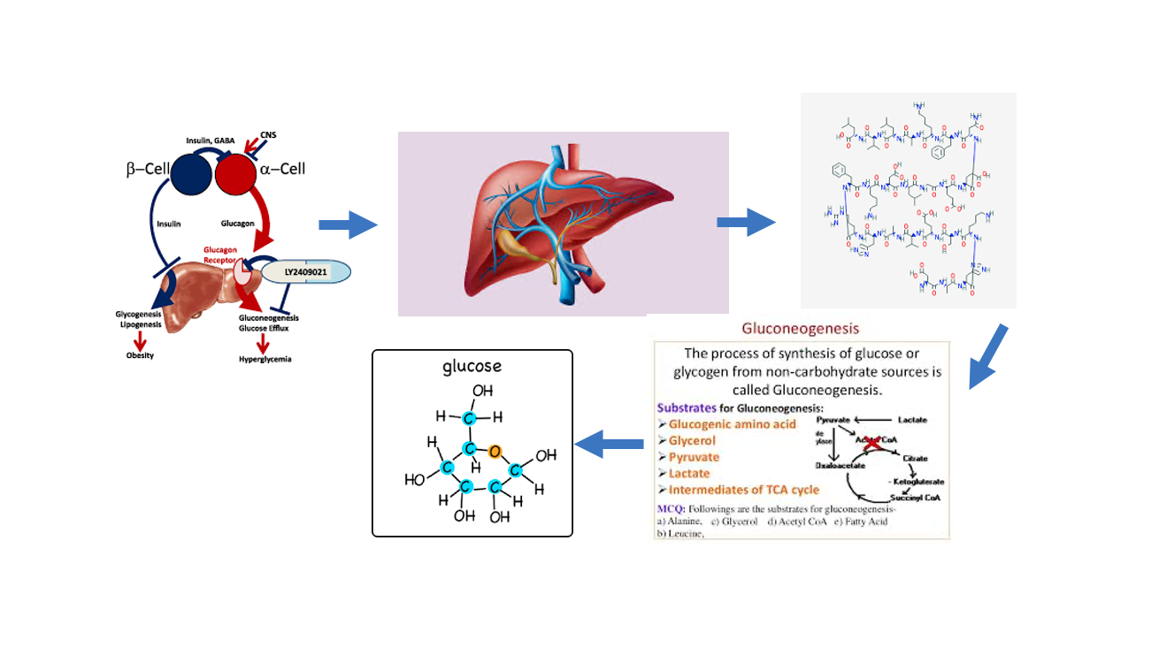
Let’s Talk More Physiology!
And when the glycogen is used up…what happens?

Slide 28
And when an Inpatient becomes hypoglycemic, what can they do?

Slide 29
How Do We Find The Data?

Slide 30
The Three Paths to Truth
Path | Pros | Cons
Administrative Data | Easy. May meet reporting requirements | Delayed. Not Timely for rapid PDCA/QI cycles Low Sensitivity. Variable Specificity
Complex Clinical Data | Requires Relational Data Base, Custom Reports, and IT prioritization | Timely Accurate
Simple Clinical Data | Ideal for low volume CAH. Little if any IT support needed | Some, but often minimal human time

Slide 31
Simple Data Example
How often do you see a glucose <50 in a patient NOT on insulin?
Assume on insulin
Count all patients who had a glucose <50 during a single admission this month. Remove duplicates.(NUMERATOR)
Count all patients who received insulin this month.(DENOMINATOR)
Divide Numerator by Denominator = RATE for month.
CLOSE ENOUGH

Slide 32
What are the Keys to Prevention?
Proven Strategies That Work

Slide 33
What Physicians Can Do
Target range 140 -180 !!
Basal + Bolus + Correction for all patients who are eating
Basal + Correction for non-critically ill patients who are nothing by mouth (NPO) or on 24-hour feeds
BASAL INSULIN FOR EVERYBODY!

Slide 34
What Physicians Can Do
AVOID Sliding Scale Insulin as the ONLY source of Glycemic Control
The ONLY EXCEPTIONS:
Patients who have been on …
outpatient ORAL regimens AND
ARE expected to have UNCOMPLICATED inpatient stays of < 48 hours AND
whose blood glucose can be controlled < 180 mg/dL
OTHERWISE, BASAL INSULIN FOR EVERYBODY!
`

Slide 35
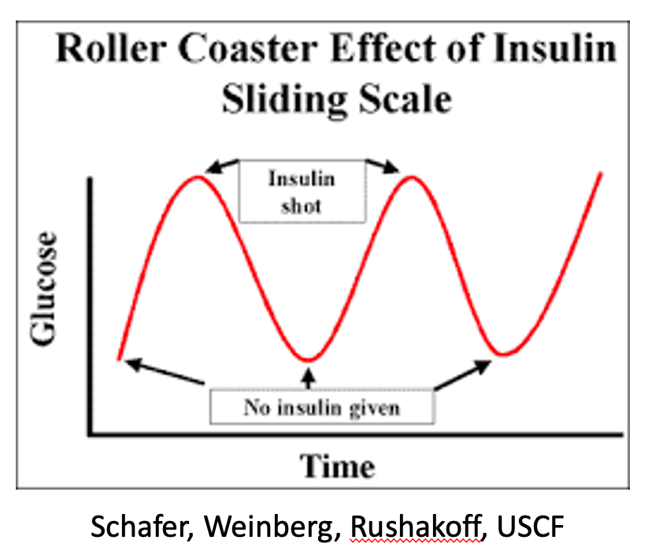
What Physicians Can Do

Slide 36
What Physicians Can Do
Consider changing insulin regimen if glucose <100 mg/dl
May eliminate 25-30% of subsequent glucoses <50
Change insulin regimen if glucose <70 mg/dl
Studies show that as many as 85% of patients with a glucose < 50 had a previous event of < 70 in the same hospitalization without a change in the insulin regimen

Slide 37
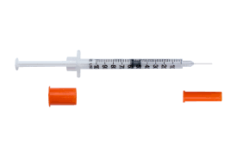
What Nurses Can Do
Coordination of meals and insulin

Slide 38
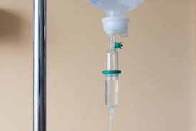
Other Proven Strategies
Assessing/Readjusting home dietary intake/home insulin dosing on admission
Standard orders for sudden NPO/loss of appetite/loss of line
Insulin drips for critically ill patients with glucose > 180 mg/dL

Slide 39
How Do We Find Out What We Need to “Fix”?
Go Discover for Yourself!

Slide 40
Hypoglycemia Process Improvement Discovery Tool
Source: http://cynosurehealth.org/wp-content/uploads/2019/11/Hypoglycemia-Process-Improvement-Discovery-Tool.pdf (PDF)

Slide 41
Conclusion

Slide 42
Think of It This Way…

Slide 43
Safe Glucose Levels in a Hospitalized Patient is Like Driving a Mountain Road
The ADA Standards of Care
The Road = 140 – 180
White line = 70
Wall = 54 mg/dl
Action at the white line keeps you from the cliff!
140- 180
70
54

Slide 44
Even More Important When Unstable

Slide 45
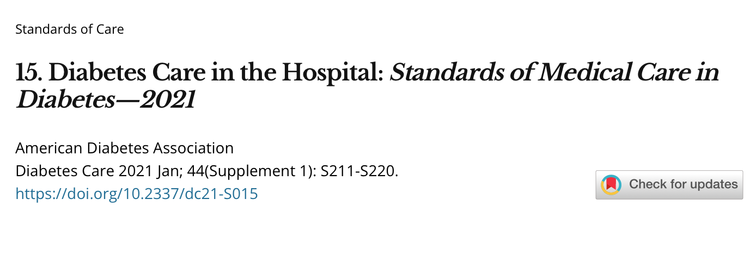
Key Reference
ADA Standards of Care in the Hospitalized Patient, 2021
https://care.diabetesjournals.org/content/44/Supplement_1/S211

Slide 46
stremain@cynosurehealth.org

Slide 47
Interactive Discussion: Speakers, Panelists and Attendees
Questions submitted at registration:
How do you engage the physicians in performance improvement?
What strategies have you found most effective for staff education?
What are your thoughts on pharmacy lead protocols?
Please Submit Additional Questions using the Q&A Feature!
Notes:
Meg-
We received many great questions at registration, we anticipated that several would be answered during today’s presentation….Lisa Bromfield agreed to answer questions on the screen.
Handoff to Rachel

Slide 48
Tools and Resources
From Today’s Speakers:
Cynosure’s Hypoglycemia Process Improvement Discovery Tool (Link)
Additional Resources:
Rural Health Information Hub (Link)
Diabetes Prevention and Management Toolkit (Link)
Food Access Toolkit (Link)
Notes:
Rachel-
Thanks so much to everyone who submitted questions and participated in today’s discussion. If we ran out of time before we could answer your question, our team will get with our guest speakers to answer remaining questions to send out to everyone on the call today along with the recording and slide deck.
Before we wrap up, we wanted to provide you with a list of resources that were mentioned today as well as in the Exploring sepsis strategies part 1 session. These resources will be sent out to you via email after today’s event. You can also find them on your affiliated HQIC’s website or secure web portal.

Slide 49
Key Takeaways
Educate front line staff as to why hypoglycemia MUST be avoided in inpatients
Implement simple ways of finding hypoglycemic events for QI improvement tracking
Look at 5 charts using the Discovery Tool and find what processes NEED to be shored up in YOUR hospital
Pick one of the above identified processes and achieve a quick win

Slide 50
Register for the Next HQIC Collaborative Event!
Save the Date
Health Equity Learning and Action Network
Tuesday, November 23rd, 2021
2:00PM-2:30PM ET
Register Here (Link)
No HQIC Collaborative Event in December
Happy Holidays!
Notes:
Please be on the lookout for the next collaborative webinar focused on ADEs and hypoglycemic solutions. Be sure to mark your calendars today!

Slide 51
Thank you for Attending Today’s Event
We value your input!
Please complete this brief evaluation after exiting the event:
https://www.surveymonkey.com/r/HypoG102021 (Link)

Slide 52
Contact Us
Alliant HQIC Team (Link)
Karen Holtz,
MT (ASCP), MS, CPHQ
Alliant Quality
Karen.holtz@allianthealth.org (e-mail)
View our Website (Link)
Compass HQIC Team (Link)
Melissa Perry, MSW, LCSW Hospital Quality Initiatives Project Coordinator perrym@ihconline.org (e-mail)
View our Website (Link)
IPRO HQIC Team (Link)
Rebecca Van Vorst, MSPH, CPHQ
HQIC Project Manager
RVanVorst@ipro.org
(e-mail)
View our Website (Link)
Telligen HQIC Team (Link)
Meg Nugent,
MHA, RN
HQIC Program Manager
mnugent@telligen.com
(e-mail)
View our Website (Link)
This material was prepared by Compass HQIC Network a Hospital Quality Improvement Contractor under contract with the Centers for Medicare & Medicaid Services (CMS), an agency of the U.S. Department of Health and Human Services (HHS). Views expressed in this material do not necessarily reflect the official views or policy of CMS or HHS, and any reference to a specific product or entity herein does not constitute endorsement of that product or entity by CMS or HHS. 12SOW Compass HQIC Network/Hospital Quality Improvement Contractor – [0044] – 10/28/2021.

