Slide 1

Preventing and Managing C. difficile
Welcome!
All lines are muted, so please ask your questions in chat
For technical issues, chat to the ‘Technical Support’ Panelist
Please actively participate in the poll that will pop up on the lower righthand side of your screen at the end of the presentation
We will get started shortly!
Notes:
To preserve the quality of the audio, we will keep all lines muted. Please chat your questions to <insert name of chat moderator> using the WebEx chat function, <insert name of chat moderator> will keep an eye out for questions and repeat them back for us when we get to the Q&A.
Throughout the call, there will be polling questions to get to know you a little better and well as for you to share your feedback with us on this presentation. A copy of the slides may be found on the Alliant Quality website.

Slide 2

Melody Brown, MSM
Aim manager, patient safety
Melody’s healthcare career started as a Medical Technologist over 35 years ago. She later shifted her focus to Infection Control, Quality Management, and JCAHO Coordination in a rural hospital setting. Melody has had varied roles at Alliant Health Solutions working on the CMS contract for the Quality Innovation Network – Quality Improvement Organization (QIN – QIO). Coaching hospitals and nursing homes on all facets of healthcare quality improvement has been her focus as the Task Manager for Performance Improvement, and most recently supporting the nursing home reporting to the CDC NHSN database for CDI.
Melody enjoys spending time with family, including her two grandchildren, camping, gardening and shopping.
Contact:
Melody.Brown@AlliantQuality.org

Slide 3

Amy Ward, MS, BSN, RN, CIC
Infection Prevention Specialist
Amy is a registered nurse with a diverse background in acute care nursing, microbiology, epidemiology and infection control. She is passionate about leading and mentoring new and future infection preventionists in their career paths. Over the past several years, her focused efforts in C. difficile infection reduction lead to significant local improvements in patient outcomes, antimicrobial stewardship, and C. difficile rates.
Amy enjoys spending time with family. She loves all the time she can get outdoors cycling and running.
Contact:
Amy.Ward@AlliantHealth.org
Notes:
Speaker

Slide 4
Objectives
Learn Today:
  Compare and contrast C. difficile infection and colonization
  Understand three foundational principles of C. difficile prevention
Use Tomorrow:
  Effectively manage residents with C. difficile infection and prevent transmission

Slide 5
The Risks and Cost of C. diff Infection (CDI)
Risks
Medications disrupting intestinal flora (antibiotics, antacids, chemotherapy, etc.)
>65 years of age
Residing in LTCF or hospitalization
Cost
14,000 deaths in 2007
$4.8 billion in excess health care costs in 2007
Average cost of CDI event: $7500
C. Difficile infection increases hospital costs by 40% per case. Infection Control Today. 2015.
Notes:
I want to first touch on the risks and costs of C. diff infection at the national level. Data shows that seniors over age 65, individuals have either taken medications that disrupt the gastrointestinal flora (meds such as antibiotics, chemotherapy, antacids, enteral feedings, etc.) or those who have close proximity to the healthcare system – meaning individuals with recent hospitalizations and those residing in long term care facilities are at much higher risk for C. diff infection.
The introduction of C. difficile spores into the gastrointestinal system, oftentimes, in the healthcare setting, lead to a colonization of the GI tract. Later, when medications that alter the normal GI flora are taken, the C. difficile can then begin producing toxins that irritate the lining of the colon, causing clinically significant diarrhea and what is known as C. diff infection.
The annual costs to the healthcare system are also astounding. 14 thousand deaths were associated with C. diff infection in 2007 along with 4.8 billion in excess healthcare costs. The average cost of a single c. difficile $7500.
It is important to remember the sheer number of residents in long term care throughout the country and what affect that has on this data. Herzit et al. estimated that between 1.13 and 2.68 million CDI infections in occurred in post acute care 2013.

Slide 6
C. diff Pilot Study
Conducted 2016-2018 in Nursing Homes
~2330 NH participated
  21% of total nationwide
C. diff data reported to NHSN
Collaboration with CMS and QIO’s
Must have SAMS grid card to participated
Objectives
  ↑ NHSN reporting
  Establish CDI Baseline
  Understand interventions
  Provide mechanism for monitoring and improving CDI rates and outcomes
Notes:
Many of you may have participated and remember the C. diff pilot study conducted from 2016 through 2018 and involved about 2300 nursing homes. Participating nursing homes obtained their level three SAMS grid card (like many of you are currently doing or just completed) and reported their facility C. difficile data to NHSN. This project was a collaboration between the participating nursing homes, the QIO’s and CMS. The objectives were to increase NHSN reporting, develop a baseline of C. diff burden in the long term care setting, understand interventions and begin to provide a mechanism for monitoring and improving rates and outcomes.

Slide 7
Who Should be Clinically Evaluated for CDI?
Residents who develop profuse, watery diarrhea (>3 stools in 24 hours)
  Continues after diarrhea causing medications are stopped
Immediately initiate contact enteric precautions
Discuss change in resident status with Provider and Infection Prevention RN
DO NOT REQUEST TESTS FOR CURE!!
Notes:
When thinking of C. diff infection, as healthcare providers we must consider two pathways or situations – clinical picture versus public health definition and reporting.
Clinically, residents who develop profuse, watery diarrhea (typically greater than 3 episodes in a 24 hour or less time period) should have an evaluation regarding the cause of diarrhea. Review MAR for diarrhea causing medications to determine if medications may be contributing and stop those meds. Initiate contact enteric precautions and discuss change in status with provider and IP RN.
If resident has C. diff upon arrival to the facility, do not request or test for cure, this is not an indicated use for a CDI PCR test.

Slide 8
Laboratory Testing for CDI
Toxin producing C. difficile – organism by culture or nucleic acid by PCR detected in the stool specimen
  PCR extremely sensitive and can pick up colonization
    If burden of CDI is significant within a facility and control measures are in place, consider adding confirmatory test
Toxin test – C. difficile toxin A or B (enzyme immunoassay or EIA test)
  Used frequently as confirmatory test
Polage et. al
Notes:
Lab testing for C. diff comes in a variety of options. The most common is PCR testing which identifies nucleic acid (DNA) from C. diff bacteria that may be present in the stool specimen. The PCR test is extremely sensitive and specific, meaning it will be positive even if very few bacteria are present.
For this reason, many hospitals have now begun to use a second step in the testing process to identify if there is also C. diff toxin present in the stool specimen. There are some excellent studies that show there is no difference in patient outcomes for patients who have a PCR + toxin – result are not treated with oral vancomycin when compared to a PCR – toxin – patient.
Upon admission to the long term care facility, you may receive both the positive PCR result and negative toxin result. A great place to discuss results that may be confusing and how they should be treated in acute versus post acute settings would be a great discussion to have with your community coalition or with the IP at the local hospital who you are receiving these results from so you have clarity and can coordinate C. diff diagnosis and prevention efforts.

Slide 9
How Should Cases be Identified and Reported to NHSN?
Nursing homes should monitor for CDI rates to understand how they can improve outcomes for residents.
Perform CDI surveillance of all residents regularly
  Review orders for C. diff tests to evaluate clinical picture
  Review lab results for positive C. diff results
  Review new admissions for recent or historical CDI
Notes:
Now that we understand C. diff infection from the clinical and diagnostic perspective, we can then begin to monitor and understand what the baseline C. diff rates are in our facility in order to identify areas for improvement. C. diff surveillance can be relatively quick and simple. IP’s should be regularly reviewing the c. diff orders to understand the signs and symptoms, medications and reasons for the order. As mentioned earlier, the pcr test is extremely sensitive and may pick up bacterial colonization in someone who has a mediation associated diarrhea episode. Often, stopping the medication will resolve the diarrhea so when we order a C. diff test when it isn’t necessarily clinically indicated, we may be diagnosing and treating a colonized individual rather than treating someone with acute C. diff infection. This practice can lead to over use of isolation precautions, poor use of antibiotics, and increased costs to the healthcare system.
The IP nurse should also review all the positive lab results for C. diff to report C. diff LabID infections to NHSN.
Finally, new admissions should be reviewed for history or recent C. diff as these patients are much more likely to have a relapse or recurrent C. diff infection.

Slide 10
C. Lab ID Definition
All non-duplicate C. difficile positive laboratory assays obtained while a resident is receiving care in the LTCF.
Lab results from outside facilities, before a resident’s admission, should not be included in LabID Event reporting.
Keep a log of all positive C. difficile tests sent from your facility to track duplicate results to ensure they are not incorrectly entered as CDI LabID Events. (Line listing, for example)
New for 2020 reporting: Facilities must submit all positive C. difficile laboratory assays collected from a resident while he/she is physically housed in the reporting LTCF (see Settings for additional information about reportable events).
Notes:
The C. diff lab ID definition is the public health definition – again it is not a clinical definition and should not be used to guide diagnosis of C. diff infection.
A c. diff lab ID event includes All non- duplicate positive laboratory assays while the resident is receiving care in the LTCF.
Lab results from outside facilities prior to resident’s admission are not included
Recommend keeping a log (line listing) of all positive C. diff results sent to track admission date, duplicate results, etc. to ensure they are not entered

Slide 11
Example C. diff Line List
Resident Name | Gender | DOB | Date of first admission | Date of current admission | Transfer from Acute care in last 4 weeks | Location | Date of symptom onset | Date of Specimen Collection | Date Positive | Date reported to NHSN
John D | M | 2/10/1852 | 6/2/2020 | 9/25/2020 | Y | Hall B | 11/5/2020 | 11/5/2020 | 11/6/2020 | 12/7/20
Susie Q | F | 11/3/1776 | 7/5/2020 | 7/5/2020 | N | Hall A | 8/15/2020 | 8/16/2020 | 8/16/2020 | 9/8/20
Roxanne | F | 3/17/1854 | 9/18/2020 | 9/18/2020 | N | Hall B | 11/2/2020 | 11/2/2020 | 11/3/2020 | 12/7/20
Jerry G | M | 5/15/1945 | 7/15/2020 | 9/15/2020 | N | Hall B | 10/31/2020 | 11/1/2020 | 11/2/2020 | 12/7/20
Susie Q | F | 11/3/1776 | 7/5/2020 | 9/28/2020 | Y | Hall B | 10/2/2020 | 10/2/2020 | 10/3/2020 | 11/5/20
Notes:
Here is an example of a C. diff line list or log that you can be keeping for all positive results. I would suggest keeping all data in the log that is on the LabID event form as well as adding a column for “reported to NHSN” so you can record the date you entered the data to NHSN. This will help in data review for trends (here you can see that Hall B is very consistent for all of the most recent events – do we need to focus in on the hand hygiene or environmental cleaning in that area?)
Keeping a line list helps us to find common themes in the data. You can also add columns such as signs and symptoms present, other laboratory data like white blood cell counts, medications they were taking like PPIs or antibiotics, tube feedings or other information from the medical record.

Slide 12
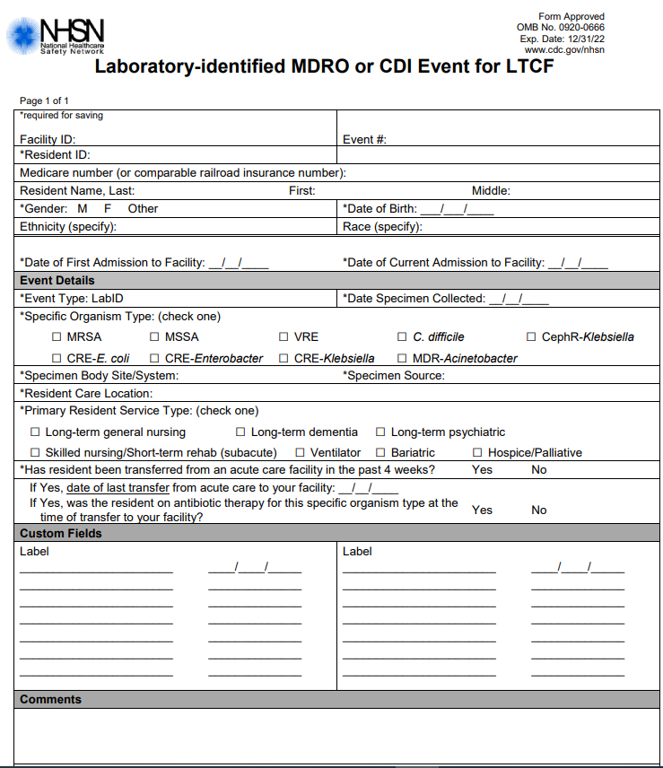
LabID Event Form
Demographic information (requires SAMS level 3 access)
Event details –
  Event Type – LabID
  Organism Type – C. difficile
  Specimen Body Site/System: GI tract
  Specimen Source: Stool
  Resident Care Location: ex. Hall B
  Resident Service Type
  Acute Care transfer? – from Medical record
Notes:
The Lab ID event form contains all the required fields for reporting an event to NHSN. You will need all this information available to enter to NHSN when you are entering the monthly data in addition to the population who was residing at the nursing home for the month. You will need the monthly totals for resident admissions, resident days, number of admissions on C. difficile treatment and C. difficile treatment starts.
You do not have to fill this form out for every event. It is helpful for determining if a positive result is a reportable event and also for knowing all the required data fields to enter to NHSN, however, this form doesn’t have to be used.

Slide 13
Polling Questions - Case Scenarios
Mrs. Antilla is admitted to your skilled nursing facility for rehab following a motor vehicle accident. According to her chart, she recently tested positive for CDI and is admitted to your facility on treatment.
Ms. Smith was admitted to your LTCF today. According to her chart she was recently treated for CDI but continues to have episodes of diarrhea. The attending physician ordered a C. difficile test and the specimen was collected on the following day. The results were positive for C. difficile toxin A,
Notes:
Is this a C. diff LabID event? No - she tested positive at the previous facility – her event will be reported by that facility
Is this a C.diff Lab ID event? Yes - this is reported as a LabID event, however, will not be considered LTCF onset due to the admission timeline and the recent CDI event at another facility.

Slide 14
Why Report C. diff Measures to NHSN?
Standard infection definitions
Epidemiology
Benchmarking
  National
  Facility level
Identify prevention targets/goals
Track Prevention Progress
Notes:
By reporting measures such as C. diff into NHSN, you will be able to focus prevention efforts. With over xxx Nursing homes enrolled and reporting C. diff data, we can better understand how your nursing home’s rates compare to other homes in your area, state, and throughout the nation. We can then focus improvement efforts and correlate where infections may be coming from whether it is the hospital, LTAC, or post acute center.

Slide 15
Sustain the Gains
Using data to improve
Utilize NHSN data analysis functions to improve upon your own C. diff rates
  Report your data by the definition – we are all in this together!
  Most widely used HAI tracking system (>22,000 facilities reporting!)
    Acute care hospitals, Ambulatory Surgery Centers, LTCF
  Facilities can use the data to
    Identify problem areas
    Measure progress of prevention efforts
    Comply with reporting requirements
Notes:
At this point in the conversation you may be in a few different positions. The first position may be that you’ve been monitoring and reporting C. diff data for several years. Maybe this has become routine for you and your rates are acceptable. Maybe you find yourself in another position where you have never reported C. diff data, you feel like this is completely foreign because you just began IP this year during the COVID crisis and that is all you have had time to focus on.
Both positions are ok right now, however, we want to continue to perform better, right?
So imagine that everyone on this webinar commits to reporting their C. diff data to the data base. We are all within a single community and our patients might travel between our facility, the nearby critical access hospital, the large tertiary medical center two hours away, a rehab facility nearby the medical center for a few weeks, and finally they come back to our facility.
Now, imagine during that time, that resident developed C. diff the day after they were admitted to rehab facility. First question is – where did this case come from? Who should report it? Where will the case be counted toward?
It can become quite a tangled web, right? So we all should report all cases that meet that labID definition every time, there isn’t any interpretation to that definition, however, the analysis of good data can be used to improve.
So say the rehab facility reports the C. diff. It will not count against the rehab facility but it will show up in the community prevalence rate. If we can understand our overall community prevalence rates, we can then better understand our facilities prevalence and incidence of C. diff infection because we now know what the risk is outside our facility and inside our facility.
It takes a village and the intention is to reduce C. diff burden together. We must have accurate and timely, and complete data to do that.

Slide 16
C. Difficile Prevention
Pillars of Prevention
Hand Hygiene
Environmental Cleaning
Antimicrobial Stewardship
Notes:
Now that we’ve discussed C. diff surveillance and reporting, preventing C. diff in the nursing home has 3 pillars - Hand hygiene, Environmental cleaning, and antimicrobial stewardship
When working to reduce C. diff rates in the facility, focus in on baseline data for each of these pillars to target interventions.

Slide 17
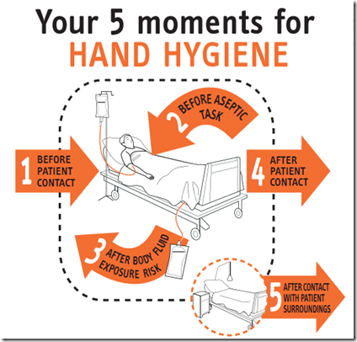
Hand Hygiene
Competency
  Do staff follow all necessary steps when performing HH?
Adherence Monitoring
  Do staff perform HH when indicated?
Improvement Plan
  Use data collected from adherence monitoring to make plans for improvement
    Is there specific shifts or disciplines that need to improve?
    Is there a hallway that is lacking equipment and therefore has low adherence rates?
Notes:
When looking at hand hygiene adherence, you will first want to be sure all staff understand how hand hygiene should be performed. Competency can be performed during orientation to the facility, annually, and as needed to ensure all staff are washing their hands per policy. (20 seconds, turn off the water with a paper towel, etc.). Competencies should be kept in the staff working file for review during site visits, for example.
Adherence monitoring, or audits, are performed regularly to determine if staff are washing their hands when indicated. For example, your facility can choose to follow the WHO 5 moments for hand hygiene and the staff would then be expected to wash hands at each of those moments. Adherence audits are not competency audits – they should be a simple numerator of if staff performed hand hygiene and denominator for the number of times indicated.
Capturing date, discipline, and work area, and even shift may be helpful with data analysis and the ability to target improvements.

Slide 18
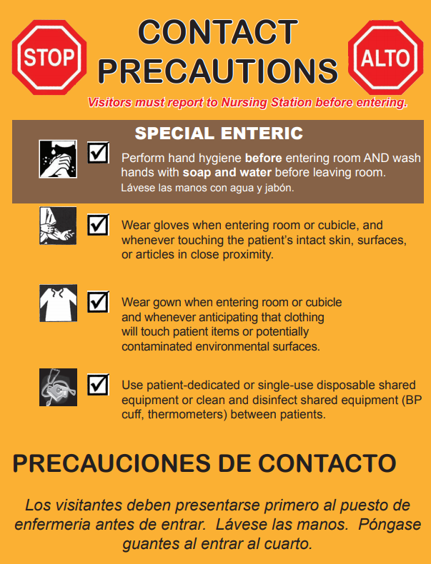
Transmission Based Precautions
Initiate immediately when CDI is suspected
Utilize Contact Enteric Precautions for all who enter the patient care area
  Hand hygiene – preferentially and in outbreaks use soap and water versus ABHR
  Gown
  Gloves
https://spice.unc.edu/resources/nc-standardized-isolation-signage/
Notes:
Use of transmission based precautions at first sign of C. diff is important to reduce potential transmission. Ensure you are using contact enteric precautions that dictate use of soap and water after leaving the resident room. Additionally gloves and gown prevent transmission via contact.
If a resident is incontinent of stool and this is uncommon for them, or they are having a change in their bowel patterns, utilize contact enteric precautions until you understand the reasons for this change in continence or patterns.

Slide 19
Environmental Cleaning
Clean and disinfect patient rooms and care equipment
Policies and Procedures
  EPA registered sporicidal disinfectants
    Quats and daily disinfectants may not be effective against C. diff
    During outbreaks, consider use of sporicidal agent for all routine disinfection
  Follow manufacturer instructions for use
  Clean shared equipment between each use (glucometer, bladder scanner, etc.)
  Follow routine practices – changing wiper/mop head, clean to dirty workflow, frequent cleaning of high touch surfaces
  Use checklists
Audits and Observations
  Define responsibilities – who cleans what
  Regularly audit to ensure cleaning is completed per policy
  Report audit findings to QAPI committee to develop action plans when needed
Notes:
Environmental cleaning is very important in C. diff reduction. We know C. diff spores are hearty and can survive on surfaces for months. Spores are then transmitted from surfaces to the GI tract by hands.
Cleaning and disinfection of the environment is an extremely important step in disrupting the chain of infection.
Follow all policies and procedures of the facility and review for use of EPA registered sporicidal disinfectants. Do not use quats for terminal cleaning or for daily cleaning if C. diff is suspected or confirmed. During active outbreaks, consider using the sporicidal agent for all routine cleaning and disinfection to reduce burden in the environment.
Review policies and procedures to ensure they state to follow manufacturers instructions for use, clean shared equipment between uses, follow routine practices such as using a single use microfiber mop head for each patient room rather than wet mops, cleaning from clean to dirty, and ensure checklists are used for all high touch surfaces.
Auditing practice can help to improve the quality of the intervention over time. Ensure every staff member has clear responsibilities for cleaning of various items. It can be astounding if you go out to the nursing areas and ask “who cleans this and how frequently?” what answers you will get.
Finally, report all audits and policy changes to QAPI committee for follow up.

Slide 20
Antimicrobial Stewardship
A set of commitments and actions designed to optimize the treatment of infections while reducing adverse events associated with antibiotic use
    Leadership Commitment Drug Expertise
    Reporting Action
    Education Tracking
    Accountability
Studies have shown that CDI, gastroenteritis, and diarrhea are the most common adverse events related to antibiotic use.
Antibiotic stewardship is about resident safety and quality care
CMS mandates nursing homes have stewardship programs in place
These programs will reduce CDI also – Bonus!
Notes:
While I go over the core elements, I’d like to open up a polling question to see how most of you are monitoring/tracking your antibiotic use data. This is one key element in a stewardship program. So, tell me – what systems do you have in place currently for monitoring antimicrobial use?
Polling question: What systems do you have in place for monitoring antimicrobial use?
Electronic based monitored by pharmacist
Electronic based monitored by nurse
Paper based monitored by Pharmacist
Paper based monitored by nurse
No monitoring in place
The Core Elements provide practical ways for nursing homes to initiate or expand antibiotic stewardship activities. The guide provides examples of how antibiotic use can be monitored and improved by nursing home leadership and staff. The companion checklist can be used to assess policies and practices already in place and to review progress in expanding stewardship activities on a regular basis. However, depending on resources, some facilities may need more time to implement all these important protections. Ultimately, nursing home antibiotic stewardship activities should, at a minimum, include the following:
Leadership commitment: Demonstrate support and commitment to safe and appropriate antibiotic use.
Accountability: Identify leaders who are responsible for promoting and overseeing antibiotic stewardship activities at the nursing home. (Medical Director, DON, Pharmacists, IPC, laboratory, health departments)
Drug expertise: Establish access to experts with experience or training in improving antibiotic use.
Action: Take at least one new action to improve the way antibiotics are used in the facility.
Tracking: Measure how antibiotics are used and the complications (e.g., C. difficile infections) from antibiotics in the facility.
Reporting: Share information with healthcare providers and staff about how antibiotics are used in the facility.
Education: Provide resources to healthcare providers, nursing staff, residents and families to learn about antibiotic resistance and opportunities for improving antibiotic use.
Review the poll and discuss introduction of one – two core elements each year.

Slide 21


Objectives Check In!
Learn Today:
  Compare and contrast C. difficile infection and colonization
  Understand three foundational principles of C. difficile prevention
Use Tomorrow:
  Effectively manage residents with C. difficile infection and prevent transmission
Complete this sentence in Chat: I will…

Slide 22
Thank You for Your Time!
Amy Ward MS, BSN, RN, CIC
Infection Prevention Specialist
Alliant Quality
Amy.Ward@AlliantHealth.org
678-527-3653

Slide 23
References
NHSN C. difficile for LTCF https://www.cdc.gov/nhsn/ltc/cdiff-mrsa/index.html
Polage, C. R., Gyorke, C. E., Kennedy, M. A., Leslie, J. L., Chin, D. L., Wang, S., ... Cohen, S.H. (2015, September 8). Overdiagnosis of Clostridium difficile infection in the molecular test era. JAMA Internal Medicine, 175, 1792-1801. http://dx.doi.org/10.1001/jamainternmed.2015.4114
IDSA Clinical Practice Guidelines https://academic.oup.com/cid/article/66/7/e1/4855916

Slide 24





CMS 12th SOW Goals
Behavioral Health
Outcomes & Opioid Misuse
Promote opioid best practices
Decrease high dose opioid prescribing and opioid adverse events in all settings
Increase access to behavioral health services
Reduce risky medication combinations
Reduce adverse drug events
Reduce C. diff in all settings
Patient Safety
Increase performance on ABCS clinical quality measures (i.e., aspirin use, blood pressure control, cholesterol management, cardiac rehab)
Identify patients at high-risk for developing kidney disease & improve outcomes
Identify patients at high risk for diabetes-related complications & improve outcomes
Chronic Disease
Self-Management
Convene community coalitions
Identify and promote optical care for super utilizers
Reduce community-based adverse drug events
Quality of Care Transitions
Improve the mean total quality score
Develop national baselines for healthcare related infections in nursing homes
Reduce emergency department visits and readmissions of short stay residents
Nursing Home Quality

Slide 25



Program Directors
Georgia, Kentucky, North Carolina and Tennessee
Leighann Sauls Leighann.Sauls@AlliantHealth.org
Alabama, Florida and Louisiana Jeana Partington Jeana.Partington@AlliantHealth.org
Notes:
--------
About Alliant Quality
Alliant Quality is the quality improvement group of Alliant Health Solutions - the Quality Innovation Network-Quality Improvement Organization (QIN-QIO) for Alabama, Florida, Georgia, Kentucky, Louisiana, North Carolina and Tennessee.
Alliant Health Solutions is a Network of Quality Innovation and Improvement Contractor (NQIIC) that implements task orders under an Indefinite Delivery/Indefinite Quantity (IDIQ) contract and currently supports quality improvement efforts to maximize impacts for QIN-QIO work, End-Stage Renal Disease (ESRD) Networks, hospital-focused large scale improvements, clinician-focused technical assistance, and other quality improvement work.
Alliant Quality has worked with providers, clinicians, and beneficiaries across the southeast to collaborate to make healthcare better for almost 50 years.
---------
About our Program Directors
Contact: Leighann for her states and Jeana for the others…
Etc…?

Slide 26
Upcoming Events
Nursing Homes Tuesdays, 2pm ET/1pm CT | Community Coalitions Thursdays, 12:30 pm ET/11:30am CT
December 15th, 2020: Preventing Healthcare Acquired Infections | November 19th, 2020: Effective Medication Reconciliation Practices Reduce Hospital Utilization and Readmissions
January 2021: TBD | December 17th, 2020: Gear up for the New Year! Positioning your Organization to Gather, Track, and Use Data in 2021

Slide 27
Making Health Care Better Together
This material was prepared by Alliant Quality, the quality improvement group of Alliant Health Solutions (AHS), the Medicare Quality Innovation Network - Quality Improvement Organization for Alabama, Florida, Georgia, Kentucky, Louisiana, North Carolina, and Tennessee, under contract with the Centers for Medicare & Medicaid Services (CMS), an agency of the U.S. Department of Health and Human Services. The contents presented do not necessarily reflect CMS policy. Publication No. 12SOW-AHSQIN-QIO-TO1NH-20-386
Notes:
The chat moderator can chat the links out at this time:
LinkedIn: https://www.linkedin.com/company/alliant-quality
Facebook: https://www.facebook.com/alliantqualityorg/
Twitter: https://twitter.com/alliantquality
YouTube: https://www.youtube.com/channel/UC9mITtil3mHpVNd87vaxD6w

