Slide 1
Shop Talk For Data Submission into the NHSN COVID-19 Module Infection Prevention "Surveillance, Tracking and Reporting“ (STAR) Facilities
June 2020
Presented by:
Marilee H. Johnson, MBA, MT (ASCP)
Technical Advisor, Infection Prevention

Slide 2
Disclaimer
I do not work for NHSN, SAMS, CDC, or CMS.
I am not the SAMS or NHSN help desk
I am the technical advisor for infection prevention for Alliant Quality, the QIO for Alabama, Florida, Georgia, Kentucky, Louisiana, North Carolina and Tennessee

Slide 3
Objectives
By the end of this session, you will be able to:
Understand how to log in and submit COVID-19 data for your facility into NHSN.
Understand how to add users, deactivate users, and change the NHSN administrator for your facility.
FAQs: Data quality, reviewing your data on the CMS website, withdrawing duplicate accounts, changing your CCN and facility type.

Slide 4
Ground Rules
Please mute your microphone
Put questions in chat
Contact me after the Webex for one-on-one assistance

Slide 5
Nursing Home Data - COVID-19
Location | # NHs listed | Submission Passed QA | No Submission or Didn't Pass QA
AL | 228 | 96% | 4%
FL | 699 | 91% | 9%
GA | 358 | 89% | 11%
KY | 285 | 94% | 6%
LA | 277 | 88% | 12%
NC | 427 | 95% | 5%
TN | 316 | 98% | 2%
Total 7 States | 2590 | 93% | 7%
US Total | 15412 | 92% | 8%
Great Job!
Data from June 7, 2020 CMS website; accessed June 18
https://data.cms.gov/stories/s/COVID-19-Nursing-Home-Data/bkwz-xpvg

Slide 6
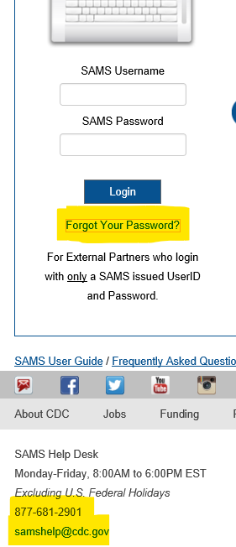
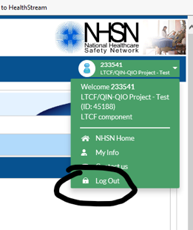
NHSN Hygiene
Don’t log in with someone else’s username and password.
You will be prompted to change your password every 60 days.
You must log in once a year or you will lose access.
Click Log Out to exit NHSN. Then close your browser.
If you forget your password, click “forgot your password” and follow the prompts.

Slide 7
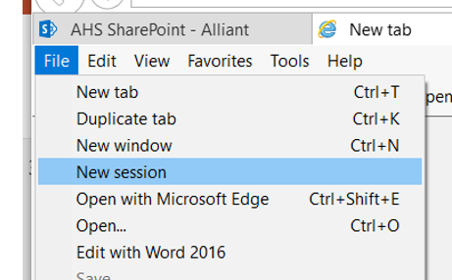
NHSN Hygiene
**Clearing the cache:
Open Internet Explorer and then click on Tools.
Then click on Internet options.
Click the General tab, and then, under Browsing history, click Delete.
Select history, cookies, temporary internet files. Then click Delete.
Start a new session:
Select File and New Session in your Toolbar.
Instead of using your bookmarks or favorites enter https://sams.cdc.gov in your browser
Enter your SAMS password and credentials

Slide 8
NHSN Hygiene: Add Users Campaign
We want YOU to add users to your NHSN account!
https://www.cdc.gov/nhsn/pdfs/ltc/ltcf-faqs-508.pdf

Slide 9
NHSN Hygiene-Option #1 Updating NHSN Facility Administrator in your Account
https://www.cdc.gov/nhsn/facadmin/index.html
And submit email to nhsn@cdc.gov including:
Facility Name, Address, Facility Org ID (5 digit number on your NHSN account), Current/Previous/Former NHSN administrator name, email, phone number and NEW NHSN administrator name, email, and phone number.
Caution: Do not use the generic email. You must use a new and unique email address (suzzie@nh.org) NOT admin@nh.org

Slide 10
NHSN Hygiene- Option #2 Preferred Updating NHSN Facility Administrator in your Account
Log into https://sams.cdc.gov
Go to the home page
Add the new administrator as a user: User>add>assign rights.
Facility>Facility Info>Reassign
Select the name of the administrator, and Save.
*Only a current NHSN Facility Administrator can reassign the Facility Administrator.
**Reassign another staff person as the NHSN facility administrator before you leave your position.

Slide 11
How do I add a user? Once the facility is enrolled and you have access to login:
Refer to page 53 on this slide: https://www.cdc.gov/nhsn/pdfs/ltc/Facility_Set_up_slides_LTCF_v5_Final_with_508_3-2015.pdf

Slide 12
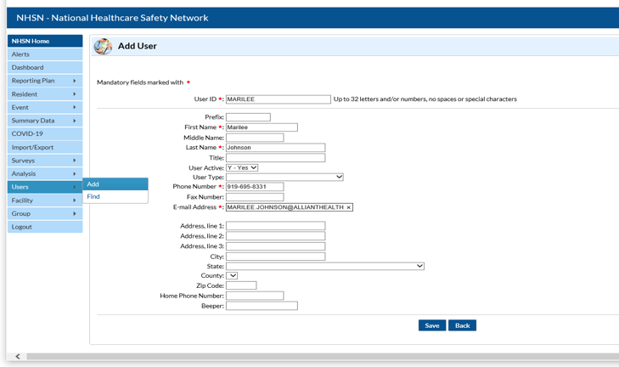
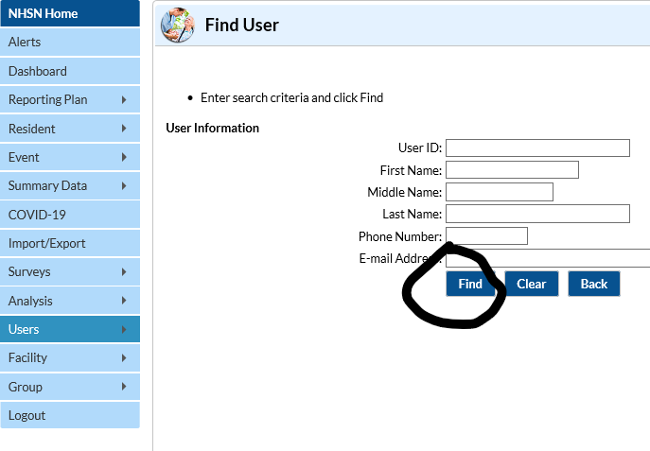
NHSN Hygiene
Users>Add.
Hint: Check users. Users>find, then find again.

Slide 13
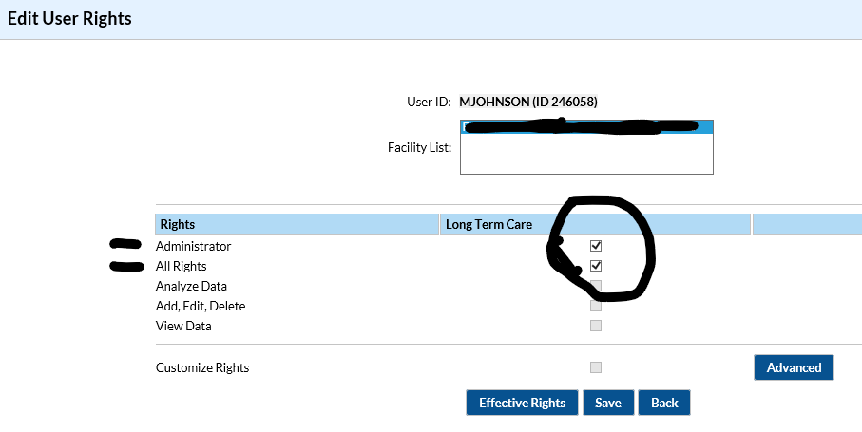
NHSN Hygiene
Add rights.

Slide 14
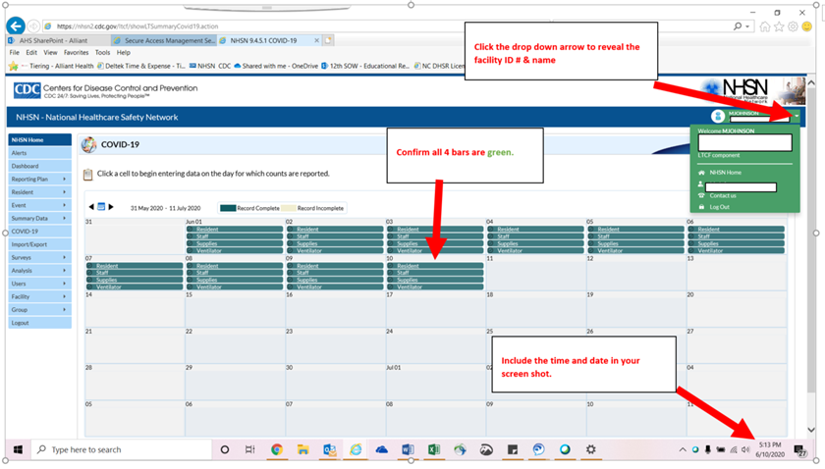
Tips for NHSN Reporting
Take a screenshot that includes the name of your facility, facility ID#, date, and time. Save for your records.

Slide 15
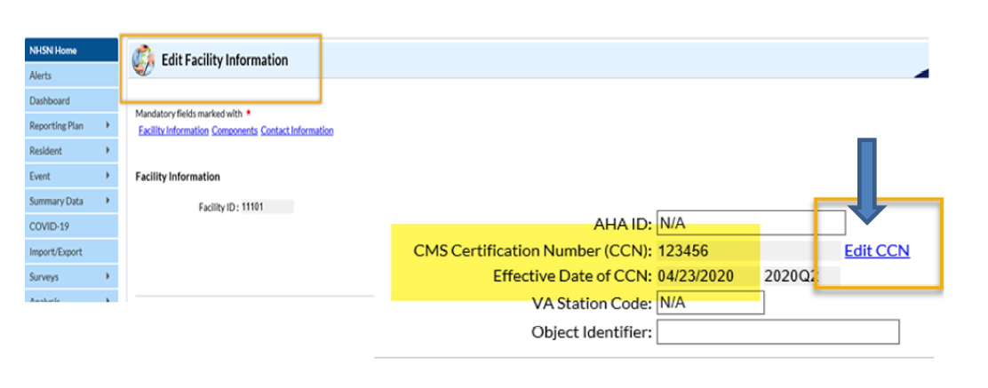
NHSN Checkpoints
Verify Your CMS/CCN Number:
https://qcor.cms.gov/main.jsp

Slide 16
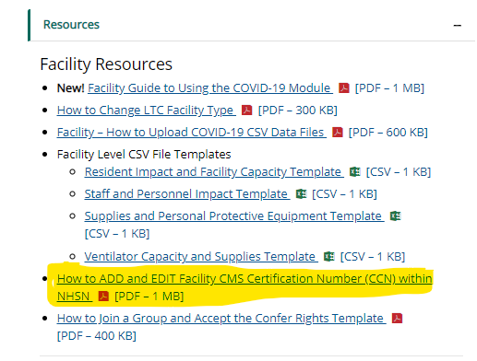
NHSN Checkpoints
Refer to the NHSN website for resources
https://www.cdc.gov/nhsn/ltc/covid19/index.html

Slide 17
NHSN Checkpoints
Watch the Covid-19 Module training video. “Yes, all 83 minutes.”
https://www.youtube.com/watch?v=-bR3CvqT9cw

Slide 18
NHSN Checkpoints
Review the Data Quality Slide Deck
https://www.cdc.gov/nhsn/pdfs/covid19/ltcf/covid19-dq-508.pdf

Slide 19
NHSN Checkpoints
https://www.cdc.gov/nhsn/pdfs/covid19/ltcf/ltcf-covid19-module-508.pdf

Slide 20
NHSN Checkpoints
Submit “Zeros” not letter O’s
Leave no blanks
Complete all 4 pathways
Make sure you are all green
https://www.cdc.gov/nhsn/pdfs/covid19/ltcf/ltcf-covid19-module-508.pdf

Slide 21
NHSN Checkpoints
Facility is entering the number of residents died incorrectly.

Slide 22
NHSN Checkpoints
collectiondate | numresadmc19 | numresconfc19 | numressuspc19 | numresdied | numresc19died | numltcfbeds | numltcfbedsocc
5/8/2020 | 1 | 0 | 0 | 27 | 0 | 134 | 112
5/11/2020 | 0 | 0 | 0 | 0 | 0 | 134 | 112
5/13/2020 | 0 | 0 | 0 | 0 | 0 | 134 | 113
5/15/2020 | 0 | 0 | 0 | 0 | 0 | 134 | 112
5/18/2020 | 0 | 0 | 0 | 1 | 0 | 134 | 112
5/20/2020 | 0 | 0 | 0 | 0 | 0 | 134 | 108
5/22/2020 | 0 | 0 | 1 | 0 | 0 | 134 | 110
5/29/2020 | 0 | 0 | 1 | 2 | 0 | 134 | 114
6/2/2020 | 0 | 0 | 0 | 0 | 0 | 134 | 113
6/4/2020 | 0 | 0 | 0 | 0 | 0 | 134 | 112
6/8/2020 | 0 | 0 | 0 | 0 | 0 | 134 | 110
6/11/2020 | 0 | 0 | 0 | 1 | 0 | 134 | 115
6/15/2020 | 0 | 0 | 0 | 0 | 0 | 134 | 115
Facility should enter number of resident who died on April 30th, rather than May 8th.

Slide 23
NHSN Checkpoints
collectiondate | numresadmc19 | numresconfc19 | numressuspc19 | numresdied | numresc19died | numltcfbeds
5/8/2020 | 0 | 23 | 0 | 6 | 6 | 154
5/15/2020 | 18 | 25 | 0 | 6 | 6 | 154
5/22/2020 | 22 | 30 | 0 | 7 | 7 | 154
5/29/2020 | 17 | 32 | 0 | 8 | 8 | 154
6/5/2020 | 13 | 37 | 0 | 11 | 11 | 154
6/12/2020 | 13 | 37 | 0 | 11 | 11 | 154
6/19/2020 | 14 | 38 | 0 | 11 | 11 | 154
Facility data did not meet CMS QA checks.
Facility should double-check their data input.
Accuracy of # of residents admitted with Covid19? Perhaps this number is total admissions? Accuracy of death count? # Confirmed is greater than number of beds?

Slide 24
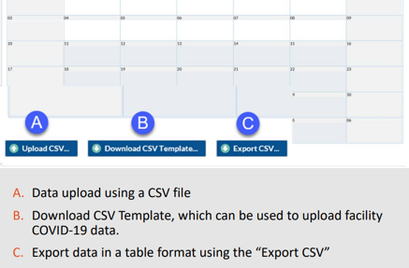
NHSN Checkpoints
For those who like excel spreadsheets, try using a template to upload your data.…
https://www.cdc.gov/nhsn/pdfs/covid19/ltcf/fac-import-csv-508.pdf

Slide 25
When should I call or email SAMS?
If you:
can’t log in with your temporary passcode
aren’t sure of applicant status
are locked out of https://sams.cdc.gov
lost your SAMS grid card
need to change your email address (must also email NHSN)
forgot your password

Slide 26
Contact Information:
NHSN Team
Enrollment and Reporting:
nhsn@cdc.gov
(no phone number)
Website:
https://www.cdc.gov/nhsn/index.html
SAMS Help Desk
Login access:
samshelp@cdc.gov
phone: 877-681-2901
Portal:
https://sams.cdc.gov

Slide 27
Contact Information:
CMS Data Links
https://www.cdc.gov/nhsn/pdfs/covid19/ltcf/faq-cms-datarelease-508.pdf
https://data.cms.gov/Special-Programs-Initiatives-COVID-19-Nursing-Home/COVID-19-Nursing-Home-Dataset/s2uc-8wxp/data

Slide 28
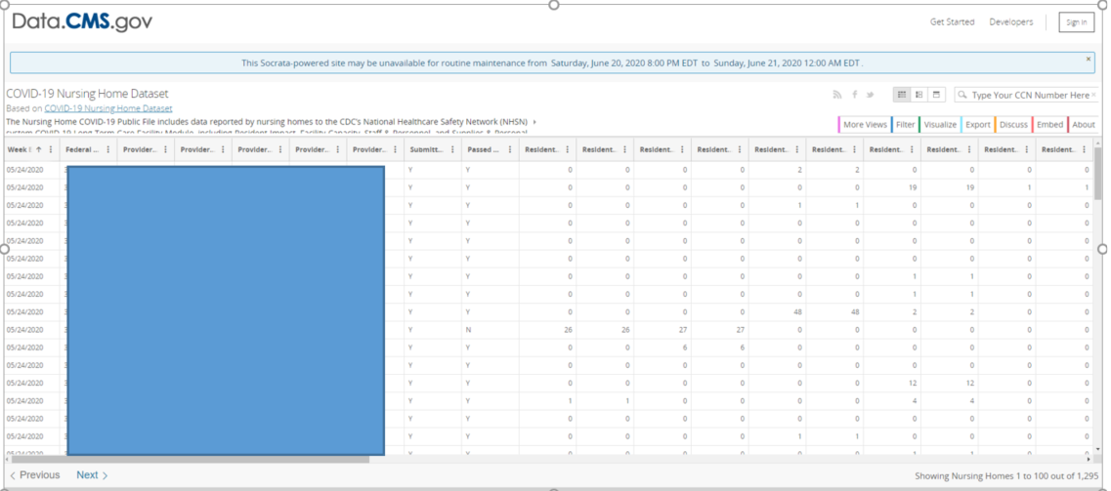
Data.cms.gov

Slide 29
New Hand Hygiene Poster & Badge
https://www.alliantquality.org/topic/hand-hygiene/

Slide 30
New Hand Hygiene Poster & Badge
You can print our Handwashing reminder on your badge!
https://www.alliantquality.org/topic/hand-hygiene/

Slide 31
Questions?
Please put your questions in chat.

Slide 32
Thank you for your time!
Marilee H. Johnson, MBA, MT (ASCP)
Technical Advisor, Infection Prevention
Alliant Quality
marilee.johnson@allianthealth.org
919-695-8331

Slide 33
Making Health Care Better Together
This material was prepared by Alliant Quality, the quality improvement group of Alliant Health Solutions (AHS), the Medicare Quality Innovation Network - Quality Improvement Organization for Alabama, Florida, Georgia, Kentucky, Louisiana, North Carolina, and Tennessee, under contract with the Centers for Medicare & Medicaid Services (CMS), an agency of the U.S. Department of Health and Human Services. The contents presented do not necessarily reflect CMS policy. Publication No. 12SOW-AHSQIN-QIO-TO1NH-20-229

